Slide 1
Optimizing Converged Cisco Networks (ONT)
Stretnutie 3: Riešenie a predchádzanie zahlteniu (Congestion Management, Congestion Avoidance)
Notes:
1

Slide 2

Frontové režimy (Queueing Mechanisms)
Notes:
1

Slide 3
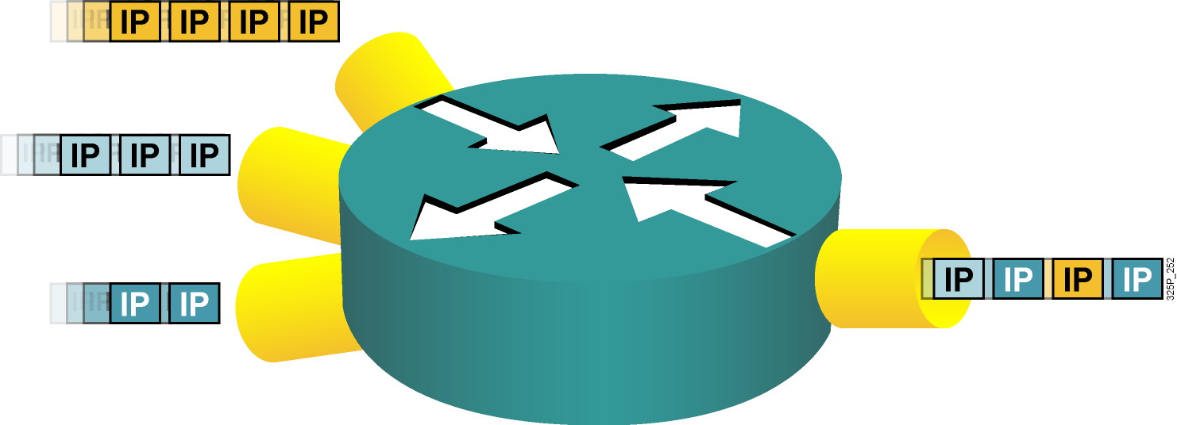
Zahltenie a ukladanie paketov do frontov
Zahltenie môže nastať na akomkoľvek mieste v sieti, kde sa realizuje agregácia alebo kde je spád v poskytovanej rýchlosti
Ukladanie do frontov riadi zahltenie poskytovaním garancií na šírku pásma a oneskorenie
Notes:
1
Congestion can occur anywhere within a network where speed mismatches (for example, a 1000-Mbps link feeding a 100-Mbps link), aggregation (for example, multiple 100-Mbps links feeding an upstream 100-Mbps link), or confluence (the joining of two or more traffic streams) accrue.
Congestion-management features control the congestion when it occurs. One way that network elements handle an overflow of arriving traffic is to use a queuing algorithm to sort the traffic and then determine some method of prioritizing it onto an output link. Each queuing algorithm was designed to solve a specific network traffic problem and has a particular effect on network performance.
Many algorithms have been designed to serve different needs. A well-designed queuing algorithm provides some bandwidth and delay guarantees to priority traffic.

Slide 4
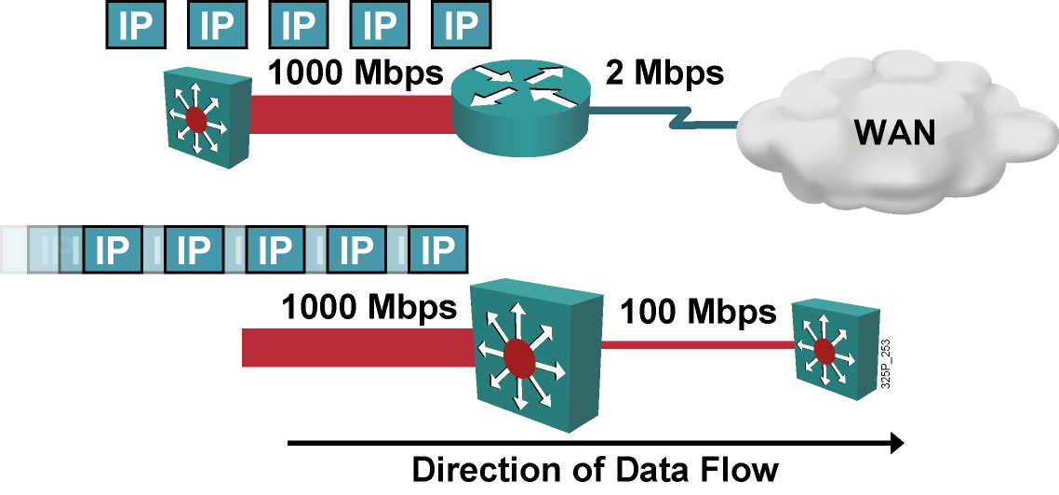
Neprispôsobenie rýchlosti
Neprispôsobenie rýchlosti je najbežnejší dôvod zahltenia
Zahltenie je pri prestupe z LAN do WAN potenciálne trvalé
Zahltenie je pri prestupe medzi dvomi LAN potenciálne dočasné
Notes:
1
Speed mismatches are the most common reason for congestion. It is possible to have persistent congestion when traffic is moving from a LAN to a WAN, such as when traffic moves from a high-speed LAN environment (100 or 1000 Mbps) to lower-speed WAN links (1 or 2 Mbps). Speed mismatches are also common in LAN-to-LAN environments when, for example, a 1000-Mbps link feeds into a 100-Mbps link, but in those cases they are transient.

Slide 5
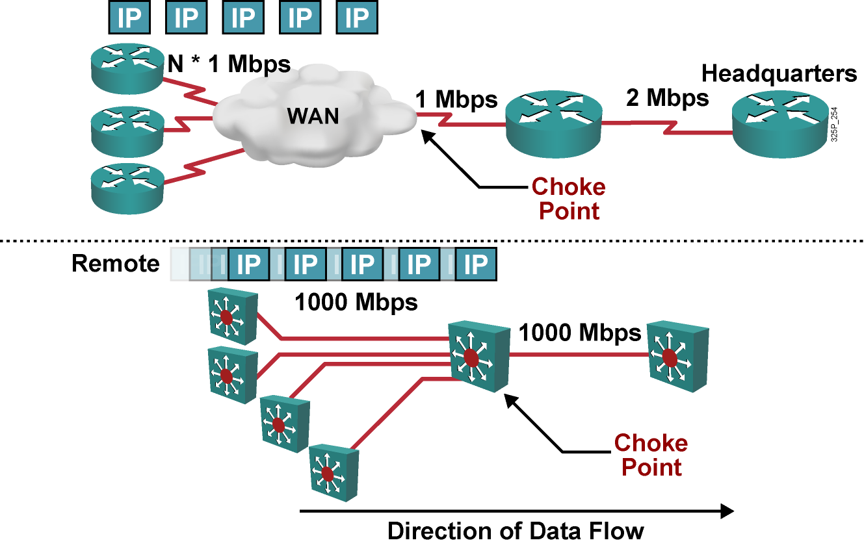
Agregácia
Notes:
1
The second most common source of congestion is points of aggregation in a network.
Typical points of aggregation occur in WANs when multiple remote sites feed into a central site.
In a LAN environment, congestion resulting from aggregation often occurs at the distribution layer of networks where the access layer devices feed traffic to the distribution layer switches.

Slide 6
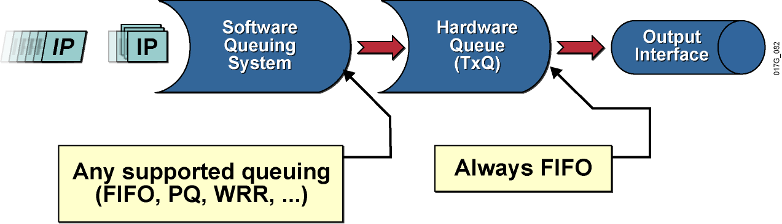
Architektúra frontového systému
Každé fyzické rozhranie má svoj hardvérový front
Nad každým fyzickým rozhraním môže pracovať systém softvérových frontov
Viacfrontové mechanizmy
Mechanizmy nad podrozhraniami (subinterfaces)
Notes:
1
Queuing on routers is necessary to accommodate bursts when the arrival rate of packets is greater than the departure rate, usually because of one of two reasons:
The input interface is faster than the output interface.
The output interface is receiving packets from multiple other interfaces.
Initial implementations of queuing used a single FIFO strategy. Better queuing mechanisms were introduced when special requirements required routers to differentiate among packets of different importance.
Queuing has two parts:
Hardware queue: Uses FIFO strategy, which is necessary for the interface drivers to transmit packets one by one. The hardware queue is sometimes referred to as the transmit queue.
Software queuing system: Schedules packets into the hardware queue based on the quality of service (QoS) requirements.

Slide 7
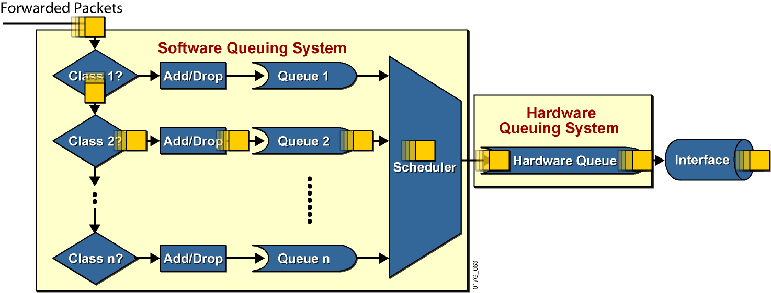
Architektúra frontového systému
Hardvérový front je vždy FIFO
Štruktúra softvérového frontového systému je konfigurovateľná podľa druhu smerovača, rozhraní a verzie IOSu
Notes:
1
Actions that must occur before transmitting a packet:
Most queuing mechanisms include classification of packets.
After a packet is classified, a router has to determine whether it can place the packet in the queue or drop the packet. Most queuing mechanisms will drop a packet only if the corresponding queue is full (tail drop). Some mechanisms use a more intelligent dropping scheme, such as weighted fair queuing (WFQ), or a random dropping scheme, such as weighted random early detection (WRED).
If the packet is allowed to be queued, it is put into the FIFO queue for that particular class.
Packets are then taken from the individual per-class queues and put into the hardware queue.

Slide 8
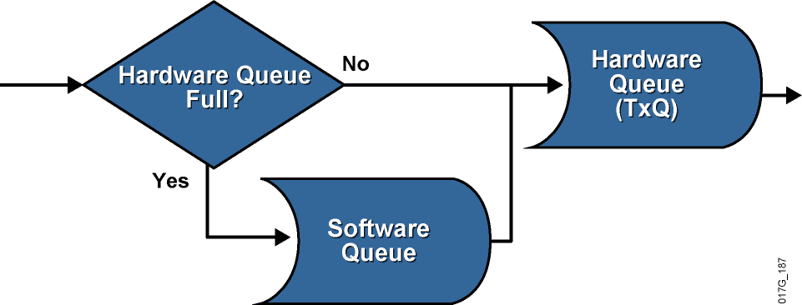
Softvérové fronty
Ak je hardvérový front rozhrania zaplnený, znamená to zahltenie rozhrania. Pakety, ktoré sa nezmestia do hardvérového frontu, sa ukladajú do softvérových frontov
Ak je v hardvérovom fronte rozhrania ešte voľné miesto, odosielaný paket sa doň vloží priamo – neprechádza softvérovým frontom
Ukladanie paketov do softvérového frontu nastáva iba vtedy, keď je hardvérový front plný
Notes:
1
The implementation of software queuing is optimized for periods when the interface is not congested. The software queuing system is bypassed whenever there is no packet in the software queue and there is room in the hardware queue.
The software queue activates only when data must wait to be placed into the hardware queue.
The double-queuing strategy (software and hardware queues) has its impacts on the results of overall queuing. Software queues serve a valuable purpose. If the hardware queue is too long, it will contain a large number of packets scheduled in the FIFO fashion. A long FIFO hardware queue most likely defeats the purpose of the QoS design requiring a certain complex software queuing system (for example, CQ).

Slide 9
Hardvérový front
Veľkosť hardvérového frontu na rozhraní je obmedzená, ale v rámci technických limitov konfigurovateľná
Smerovače určujú veľkosť hardvérového frontu rozhrania automaticky na základe konfigurovanej prenosovej kapacity (bandwidth)
Veľkosť hardvérového frontu je možné priamo konfigurovať na rozhraní príkazom tx-ring-limit
Zmenšenie veľkosti hardérového frontu má dve základné výhody:
Skráti čas čakania v hardvérovom fronte
Urýchli aktiváciu softvérových frontových mechanizmov v IOSe
Nevhodné nastavenia však môžu spôsobiť neželané efekty:
Pridlhý hardvérový front spôsobí dlhé čakanie paketov a oneskorenú aktiváciu softvérových frontových disciplín
Prikrátky hardvérový front môže viesť k nadmernému počtu prerušení (IRQ), ktoré zaťažujú CPU a presúvajú úzke hrdlo (aj) naň
Notes:
1
The length of the transmit queue is dependant on the hardware, software, Layer 2 media, and queuing algorithm configured on the interface. The default transmit queue size is determined by Cisco IOS software, is based on the bandwidth of the media, and should be fine for most queuing implementations. Some platforms and QoS mechanisms automatically adjust the transmit queue size to an appropriate value.
Faster interfaces have longer hardware queues because they produce less delay. Slower interfaces have shorter hardware queues to prevent too much delay in the worst-case scenario in which the entire hardware queue is full of MTU-size packets.

Slide 10
Zistenie aktuálnej dĺžky hardvérového frontu
Príkaz show controllers uvádza veľkosť hardvérového frontu zvoleného rozhrania
R1# show controllers serial 0/1/0
Interface Serial0/1/0
Hardware is GT96K
DCE V.11 (X.21), clock rate 384000
<...part of the output omitted...>
1 sdma_rx_reserr, 0 sdma_tx_reserr
0 rx_bogus_pkts, rx_bogus_flag FALSE
0 sdma_tx_ur_processed
tx_limited = 1(2), errata19 count1 - 0, count2 - 0
Receive Ring
rxr head (27)(0x075BD090), rxr tail (0)(0x075BCEE0)
rmd(75BCEE0): nbd 75BCEF0 cmd_sts 80800000 buf_sz 06000000 buf_ptr 75CB8E0
rmd(75BCEF0): nbd 75BCF00 cmd_sts 80800000 buf_sz 06000000 buf_ptr 75CCC00
<...rest of the output omitted...>
Notes:
1
The show controllers serial 0/1/0 command is used to see the length of the transmit queue.
The transmit queue length is shown as the tx_limited or tx_ring_limit or tx_ring statement and varies depending on the platform.
Example output
The output of the show command shows the length of the transmit queue.
In this example, the hardware queue length is defined by the tx_limited statement and equals two packets.

Slide 11
Zahltenie na softvérových rozhraniach
Podrozhrania a softvérové rozhrania (dialery, tunely, subinterface-y) nemajú svoj vlastný výstupný front
Tieto rozhrania trpia zahltením vtedy, keď sa zahltí výstupný hardvérový front na hlavnom hardvérovom rozhraní
Pojmy “TxQ” a “tx-ring” oba označujú hardvérový front a je ich možné voľne zamieňať
Notes:
1
Subinterfaces and software interfaces do not have their own separate transmit queues; they use the main transmit queue.
Software interface types include dialers, tunnels, and Frame Relay subinterfaces, and they will congest only when their main hardware interface transmit queue congests.
The transmit (tx‑ring) state is an indication of congestion of hardware interfaces caused by a congestion on the main hardware interface.

Slide 12
Čo sú to frontové disciplíny (Queuing)?
Frontové disciplíny (režimy, mechanizmy) sú mechanizmy na riadenie (zvládnutie) zahltenia na rozhraniach
Frontové disciplíny sú navrhnuté tak, aby obslúžili prechodné zahltenie rozhrania odložením nadbytočných paketov do vyrovnávacích pamätí (frontov), pokým nebude rozhranie opäť dostupné
Existujúce elementárne frontové disciplíny:
First-in, first-out (FIFO)
Priority queuing (PQ)
Round robin (RR)
Weighted round robin (WRR), Custom queueing (CQ)
Notes:
1
Queuing is a congestion-management mechanism that allows you to control congestion by determining the order in which identified packets leave an interface based on priorities assigned to those packets. Congestion management entails creating queues, assigning packets to those queues based on the classification of the packet, and scheduling the packets in a queue for transmission.
The default mechanism on most interfaces is the very simplistic first-in, first-out (FIFO) queue. Some traffic types, such as voice and video, have very demanding delay and jitter requirements, so more sophisticated queuing mechanisms must be configured on interfaces used by voice and video traffic.
Cisco IOS routers support several queuing methods to meet the varying bandwidth, jitter, and delay requirements of different applications.

Slide 13
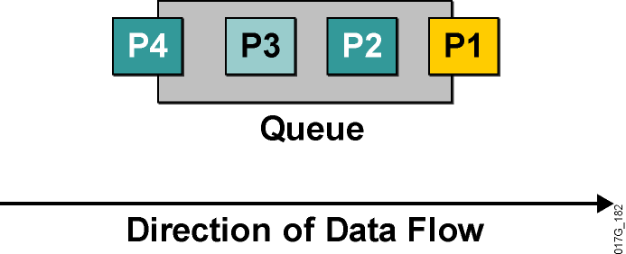
Frontový režim FIFO
Pakety sa odosielajú v poradí, v ktorom prišli
Definitívne najjednoduchší
Využíva jeden front
V iných mechanizmoch sa využíva niekoľko frontov, každý z nich je sám osebe FIFO
FIFO preto tvorí veľmi dôležitý základ všetkých ďalších mechanizmov
Notes:
1
In its simplest form, FIFO queuing—also known as first-come, first-served queuing—involves storing packets when the network is congested and forwarding them in order of arrival when the network is no longer congested.
FIFO embodies no concept of priority or classes of traffic and consequently makes no decision about packet priority. There is only one queue, and all packets are treated equally. Packets are placed into a single queue and transmitted in the order in which they arrive. Higher-priority packets are not transmitted faster than lower-priority packets.
When no other queuing strategies are configured, all interfaces except serial interfaces at E1 (2.048 Mbps) and below use FIFO by default. FIFO, which is the fastest method of queuing, is effective for links that have little delay and minimal congestion. If your link has very little congestion, FIFO queuing may be the only queuing you need to use.
All individual queues are, in fact, FIFO queues. Other queuing methods rely on FIFO as the underlying queuing mechanism for the discrete queues within more complex queuing strategies that support advanced functions such as prioritization.

Slide 14
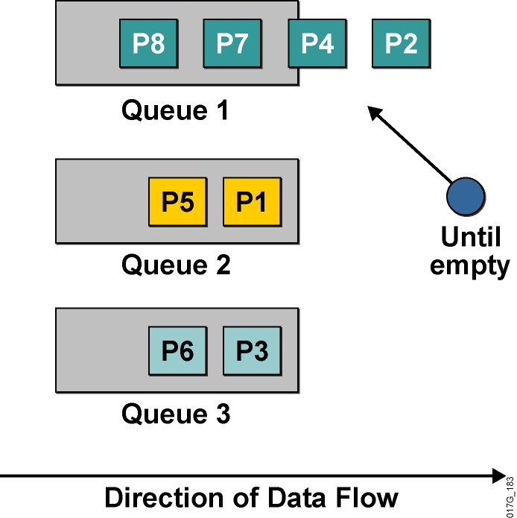
Frontový režim Priority Queuing
Používa viaceré fronty
Umožňuje stanoviť absolútne priority
Plánovač vždy vyberá pakety z frontu s najvyššou prioritou, v ktorom sa ešte nachádzajú čakajúce pakety
Front s najvyššou prioritou má garantovanú obsluhu
Hrozí riziko starvácie menej prioritných frontov
Je veľmi ťažké garantovať oneskorenie v menej prioritných frontoch
Notes:
1
Priority Queuing (PQ) allows network administrators to prioritize traffic in the network. A series of filters based on packet characteristics can be defined to cause the router to place traffic into a queue. The queue with the highest priority is serviced first until it is empty, then the lower queues are serviced in sequence.
During transmission, PQ gives priority queues absolute preferential treatment over low-priority queues; important traffic, given the highest priority, will always take precedence over less important traffic.
A priority list is a set of rules that describe how packets should be assigned to priority queues. A priority list might also describe a default priority or the queue size limits of the various priority queues.
Packets can be classified by the following:
Protocol type
Incoming interface
Packet size
Fragments
Access control list (ACL)
Keepalives sourced by the network server are always assigned to the high-priority queue; all other management traffic (such as Enhanced Interior Gateway Routing Protocol [EIGRP] updates) must be configured.
Although you can enable priority output queuing for any interface, it is best suited to low-bandwidth, congested serial interfaces.
When you choose to use PQ, consider that, because lower-priority traffic is often denied bandwidth in favor of higher-priority traffic, the use of PQ could, in the worst case, result in lower-priority traffic never being transmitted (the lower-priority traffic class is “starved”). To avoid this problem, you can use traffic shaping to rate-limit the higher-priority traffic.
PQ introduces extra overhead that is acceptable for slow interfaces but that may not be acceptable for higher-speed interfaces such as Ethernet. With PQ enabled, the system takes longer to switch packets because the packets are classified by the processed switch path. Furthermore, PQ uses a static configuration that does not adapt readily to changing network conditions.

Slide 15
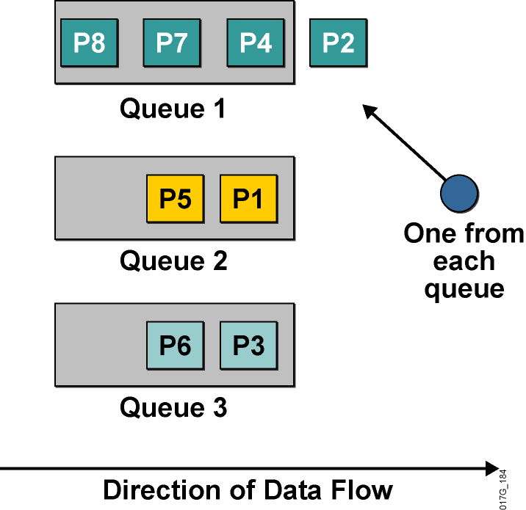
Frontový režim Round Robin Queuing
Využíva viaceré fronty
Nepodporuje priority
Plánovač v nekonečnom cykle prechádza frontami v pevnom poradí a z každého pri jednom prechode vyberie jeden paket na odoslanie
Každý front má garantované, že plánovač z neho do istého času odoberie paket
Podiel prenosového pásma pripadajúci na jeden front sa však nedá garantovať
Notes:
1
Round robin refers to an arrangement that involves choosing all elements in a group equally in some rational order, usually starting from the top to the bottom of a list and then starting again at the top of the list and so on. A simple way to think of round robin is that it is about “taking turns.” In round-robin queuing, one packet is taken from each queue and then the process repeats.
If all packets are the same size, all queues share the bandwidth equally. If packets being put into one queue are larger, that queue will receive a larger share of bandwidth.
No queue will “starve” with round-robin queuing because all queues receive an opportunity to dispatch a packet every round.
A limitation of round-robin queuing is the inability to prioritize traffic.

Slide 16
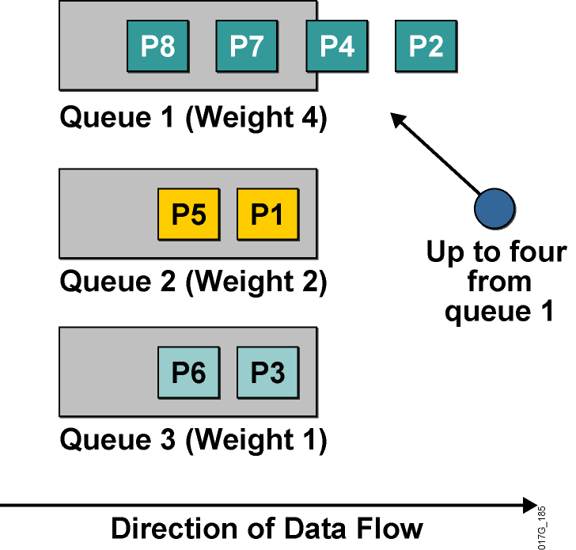
Frontový režim Weighted Round Robin Queuing
Vylepšenie obyčajného RRQ
Podporuje priority
Každému frontu prideľuje váhu
Fronty obsluhuje cyklicky ako RRQ, avšak z každého frontu vyberie počet paketov úmerný váhe frontu
Existujú implementácie, kde namiesto počtu paketov je definovaný objem dát, ktorý sa má z frontu odoslať
Táto implementácia sa volá Custom Queueing (CQ)
Notes:
1
The weighted round robin (WRR) algorithm provides prioritization capabilities for round-robin queuing as shown here.
In WRR, packets are accessed round-robin style, but queues can be given priorities called “weights.” For example, in a single round, four packets from a high-priority class might be dispatched, followed by two from a middle-priority class, and then one from a low-priority class.
Some implementations of the WRR algorithm provide prioritization by dispatching a configurable number of bytes each round rather than a number of packets. The Cisco custom queuing (CQ) mechanism is an example of this implementation.

Slide 17
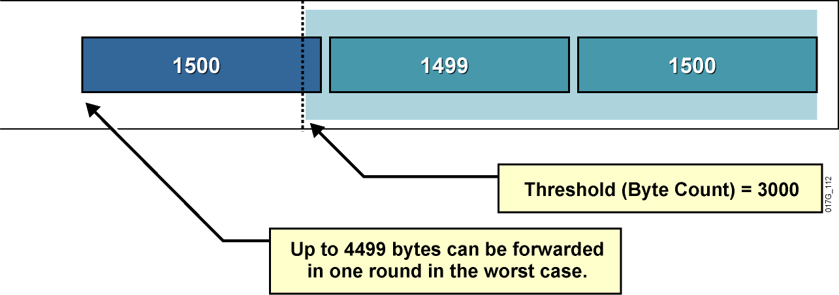
Problémy s Weighted Round Robin Queuing
Vo WRR (CQ) môže dochádzať k vychýleniu skutočných váh frontov
CQ dovoľuje v jednom prechode plánovača odoslať z frontu istý počet bajtov tým, že sa odošle hneď niekoľko paketov
Plánovač však môže odoslať paket aj vtedy, ak celkový počet odoslaných bajtov je väčší než povolená váha frontu
Notes:
1
This slide illustrates the worst-case scenario of the WRR algorithm, which uses the following parameters to implement WRR queuing on an interface:
The maximum transmission unit (MTU) of the interface is 1500 bytes.
The byte count to be sent for the queue in each round is 3000 bytes (twice the MTU).
The example shows that the router first sent two packets with a total size of 2999 bytes. Because this size is within the limit (3000), the router can send the next packet (which is MTU-sized, 1500 bytes). The result is that the queue received almost 50 percent more bandwidth in this round than it should have received.
This example shows one of the drawbacks of WRR queuing—it does not allocate bandwidth accurately.
The limit or weight of the queue is configured in bytes. The accuracy of WRR queuing depends on the weight (byte count) and the MTU. If the ratio between the byte count and the MTU is too small, WRR queuing will not allocate bandwidth accurately.
If the ratio between the byte count and the MTU is too large, WRR queuing will cause long delays.

Slide 18

Weighted Fair Queueing (WFQ)
Notes:
1

Slide 19
Frontový režim Weighted Fair Queuing
Frontový režim, ktorý realizuje „férovú“ politiku, by sa mal správať podľa týchto kritérií:
Znižovať dobu odozvy pre interaktívne toky tým, že ich uprednostní pred ostatnými
Zabrániť veľkoobjemovým tokom monopolizáciu rozhrania
Ideálny férový algoritmus by mal cyklicky obsluhovať všetky fronty a z každého vybrať v jednom cykle jeden bit
Tento prístup je v paketových sieťach nepoužiteľný
Možno ho však nahradiť približným postupom:
Pre každý front si viesť evidenciu, koľko dát celkovo bude z neho odoslaných, ak z neho odošleme ďalší paket
Obsluhovať vždy ten front, z ktorého je vrátane nasledujúceho paketu celkovo odoslaných najmenej dát
Evidentne, treba sa starať o najzaostávajúcejší front
Notes:
1
WFQ is a dynamic scheduling method that provides fair bandwidth allocation to all network traffic. WFQ applies priority, or weights, to identified traffic to classify traffic into conversations and determine how much bandwidth each conversation is allowed relative to other conversations.
WFQ is a flow-based algorithm that simultaneously schedules interactive traffic to the front of a queue to reduce response time and fairly shares the remaining bandwidth among high-bandwidth flows. In other words, WFQ allows you to give low-volume traffic, such as Telnet sessions, priority over high-volume traffic, such as FTP sessions. WFQ gives concurrent file transfers balanced use of link capacity; that is, when multiple file transfers occur, the transfers are given comparable bandwidth.
WFQ solves problems inherent in the following queuing mechanisms:
FIFO queuing causes starvation, delay, and jitter.
Priority queuing (PQ) causes starvation of lower-priority classes and suffers from the FIFO problems within each of the four queues that it uses for prioritization.

Slide 20
Frontový režim Weighted Fair Queueing
Front 1, 200-bajtové pakety
Front 2, 150-bajtové pakety
Front 3, 100-bajtové pakety
Krok | Front 1 | Front 2 | Front 3
0 | 200 | 150 | 100
1 | 200 | 150 | 200
2 | 200 | 300 | 200
3 | 400 | 300 | 200
4 | 400 | 300 | 300
5 | 400 | 450 | 300
6 | 400 | 450 | 400
7 | 600 | 450 | 400
8 | 600 | 450 | 500
9 | 600 | 600 | 500
10 | 600 | 600 | 600

Slide 21
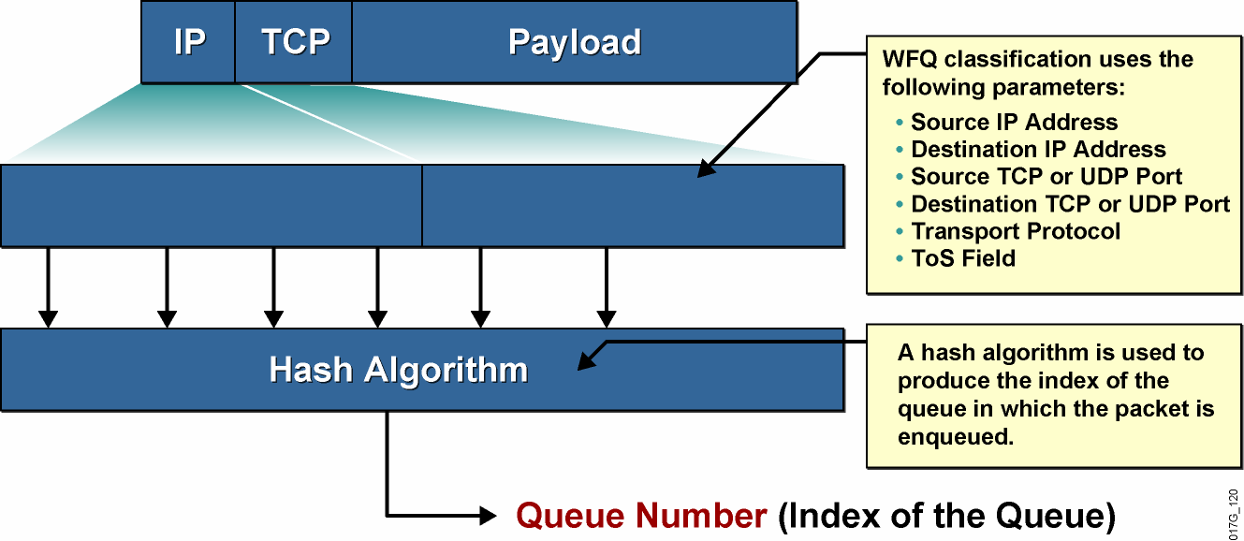
Konverzačné fronty vo WFQ
Source
IP
Address
Destination
IP
Address
Source
Port
Destination
Port
Protocol
ToS
Pakety rovnakého toku patria do rovnakého konverzačného frontu
Notes:
1
WFQ classification has to identify individual flows. This graphic shows how a flow is identified based on the following information taken from the IP header and the TCP or User Datagram Protocol (UDP) headers:
Source IP address
Destination IP address
Protocol number (identifying TCP or UDP)
Type of service field
Source TCP or UDP port number
Destination TCP or UDP port number
These parameters are usually fixed for a single flow, although there are some exceptions. For example, a quality of service (QoS) design can mark packets with different IP precedence bit values even if they belong to the same flow. You should avoid such marking when using WFQ.
The parameters are used as input for a hash algorithm that produces a fixed-length number that is used as the index of the queue.

Slide 22
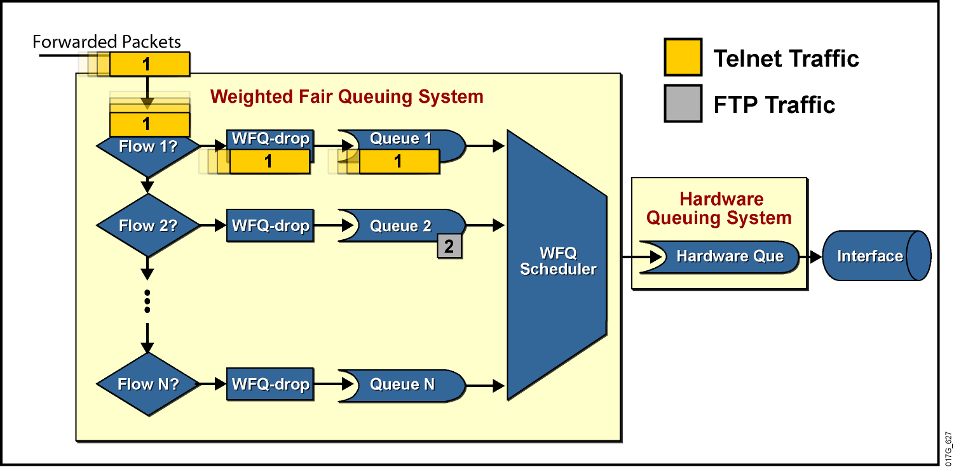
Architektúra frontov vo WFQ
Každý konverzačný front je typu FIFO
WFQ automaticky roztrieďuje jednotlivé konverzácie (toky) do frontov
Notes:
1
WFQ is a dynamic scheduling method that provides fair bandwidth allocation to all network traffic. WFQ applies weights to identified traffic, classifies traffic into flows, and determines how much bandwidth each flow is allowed, relative to other flows.
The WFQ method works as the default queuing mode on serial interfaces configured to run at or below E1 speeds (2.048 Mbps).
WFQ provides the solution for situations in which it is desirable to provide consistent response times to heavy and light network users alike, without adding excessive bandwidth. In addition, WFQ can manage duplex data flows, such as those between pairs of applications, and simplex data flows, such as voice or video.
Although WFQ automatically adapts to changing network traffic conditions, it does not offer the precise degree of control over bandwidth allocation that custom queuing (CQ) and class-based weighted fair queuing (CBWFQ) offer.
The significant limitation of WFQ is that it is not supported with tunneling and encryption because these features modify the packet content information required by WFQ for classification.

Slide 23
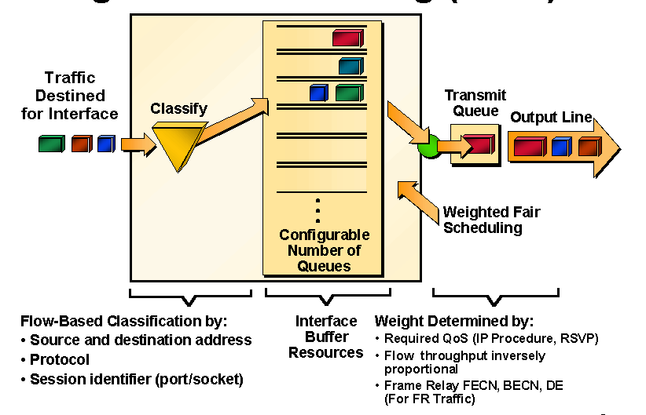
Prehľad činnosti WFQ
Notes:
1
For situations in which it is desirable to provide consistent response time to heavy and light network users alike without adding excessive bandwidth, the solution is Weighted Fair Queuing (WFQ). WFQ uses a flow-based queuing algorithm that does two things simultaneously:
It schedules interactive traffic to the front of the queue to reduce response time.
It fairly shares the remaining bandwidth among the various flows to prevent high-volume flows from monopolizing the outgoing interface.
The basis of WFQ is to have a dedicated queue for each flow without starvation, delay, or jitter within the queue. Furthermore, WFQ allows fair and accurate bandwidth allocation among all flows with minimum scheduling delay. WFQ makes use of the IP precedence bits as a weight when allocating bandwidth. Low-volume traffic streams, which comprise the majority of traffic, receive preferential service, transmitting their entire offered loads in a timely fashion. High-volume traffic streams share the remaining capacity proportionally between them.

Slide 24
Princíp činnosti WFQ
Vo WFQ každý paket v každom konverzačnom fronte dostáva tzv. sekvenčné číslo
Toto číslo vlastne vyjadruje celkový pomyselný objem dát prenesený týmto frontom vrátane daného paketu
Sekvenčné číslo sa pre paket vypočíta vzťahom
Sn+1 = Sn + váha * veľkosť paketu
kde Sn je poradové číslo predchádzajúceho paketu vo fronte a váha je číslo vypočítané zo vzťahu 32384/(IPPrecedence+1)
Váha umožňuje preferovať toky s vyššou hodnotou IP Precedence
Ak je daný konverzačný front prázdny, potom sa za Sn berie poradové číslo naposledy vloženého paketu do TxQ
Čím väčšia je precedencia paketu, tým menšia je jeho váha => paket s nižším prioritným číslom má väčšiu prioritu
Plánovač WFQ vyberá na odoslanie vždy paket s najnižším sekvenčným číslom
Obsluha je venovaná frontu, ktorý má doposiaľ najmenší podiel na celkovom objeme prevádzky odchádzajúcej daným rozhraním

Slide 25
Ako WFQ zahadzuje pakety
WFQ zahadzuje pakety na dvoch úrovniach:
Zahadzovanie pri dosiahnutí prahu Congestive Discard Threshold (počet paketov v danom konverzačnom fronte)
Agresívne zahadzovanie pri dosiahnutí limitu hold-queue (celkový počet paketov vo WFQ systéme)
WFQ vždy zahadzuje pakety najagresívnejšieho toku
Výnimka:
Paket umiestnený do prázdneho konverzačného frontu nikdy nebude zahodený
Notes:
1
The WFQ system has a hold queue that represents the queue depth, which means the number of packets that can be held in the queue. WFQ uses the following two parameters that affect the dropping of packets:
The congestive discard threshold (CDT) is used to start dropping packets of the most aggressive flow, even before the hold-queue limit is reached.
The hold-queue limit defines the maximum number of packets that can be held in the WFQ system at any time.
There are two exceptions to the WFQ insertion and drop policy:
If the WFQ system is above the CDT limit, the packet is still enqueued if the specific per‑flow queue is empty.
The dropping strategy is not directly influenced by IP precedence.
The length of queues (for scheduling purposes) is determined not by the sum of the size in bytes of all the packets but by the time it would take to transmit all the packets in the queue. The end result is that WFQ adapts to the number of active flows (queues) and allocates equal amounts of bandwidth to each flow (queue).
The side effect is that flows with small packets (usually interactive flows) get much better service because they do not need a lot of bandwidth. They need low-delay handling, however, which they get because small packets have a low finish time.

Slide 26
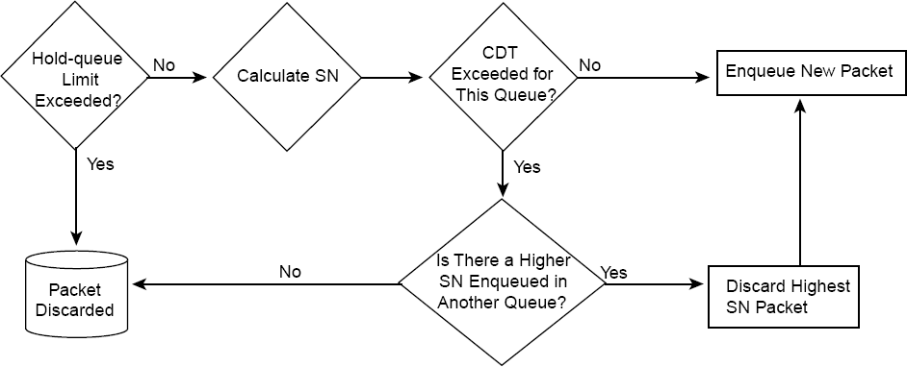
Ako WFQ zahadzuje pakety
Pojmy:
Hold-queue: limit na celkový počet paketov vo WFQ systéme
Congestive Discard Threshold: obmedzenie veľkosti individuálneho konverzačného frontu

Slide 27
Vlastnosti WFQ
WFQ používa predkonfigurovaný pevný počet konverzačných frontov
Na prevod vlastností toku na číslo frontu sa používa hashovacia funkcia
Systémové pakety a RSVP toky sú mapované na osobitné fronty
Je možné, že dva alebo viac tokov vďaka hash funkcii bude patriť do rovnakého konverzačného frontu
V takom prípade sa budú deliť o pridelené prostriedky
Dôležité: Počet nakonfigurovaných frontov by mal byť výrazne vyšší ako predpokladaný počet tokov
Notes:
1
WFQ uses a fixed number of queues. The hash function is used to assign a queue to a flow. There are eight additional queues for system packets and optionally up to 1000 queues for Resource Reservation Protocol (RSVP) flows. The number of dynamic queues that WFQ uses by default is based on the interface bandwidth.
With the default interface bandwidth, WFQ uses 256 dynamic queues. The number of queues can be configured in the range between 16 and 4096 (the number must be a power of 2).
If there are a large number of concurrent flows, it is likely that two flows could end up in the same queue. You should have several times as many queues as there are flows (on average). This design may not be possible in larger environments where concurrent flows number in the thousands.

Slide 28
Výhody a nevýhody WFQ
Výhody | Jednoduchá konfigurácia bez potreby klasifikácie Všetkým tokom garantuje isté pásmo Zahadzuje pakety najagresívnejších tokov Podporované na väčšine platforiem a IOS verzií
Nevýhody | Riziko, že viaceré toky pôjdu do rovnakého konverzačného frontu Neumožňuje externú kontrolu nad klasifikáciou Podporované na linkách najviac 2 Mb Neumožňuje poskytovať pevné garancie na pásmo
Notes:
1
The WFQ mechanism provides simple configuration (no manual classification is necessary) and guarantees throughput to all flows. It drops packets of the most aggressive flows. Because WFQ is a standard queuing mechanism, most platforms and most Cisco IOS versions support WFQ.
As good as WFQ is, it does have its drawbacks:
Multiple flows can end up in a single queue.
WFQ does not allow a network engineer to manually configure classification. Classification and scheduling are determined by the WFQ algorithm.
WFQ is supported only on links with a bandwidth less than or equal to 2 Mb.
WFQ cannot provide fixed guarantees to traffic flows.

Slide 29
Konfigurácia WFQ (len pre staré IOSy)
router(config-if)#
fair-queue [cdt [dynamic-queues [reservable-queues]]]
cdt: Počet správ povolený v individuálnych konverzačných frontov. Číslo musí byť mocninou 2
dynamic-queues: Počet dynamických konverzačných frontov. Číslo je mocninou 2 v rozsahu 16, 32, 64, 128, 256, 512, 1024, 2048 a 4096; predvolená hodnota je 256
reservable-queues: Počet frontov pre RSVP rezervácie v rozsahu od 0 do 1000. Predvolená hodnota je 0
router(config-if)#
hold-queue max-limit out
Udáva maximálny počet paketov vo WFQ systéme
Predvolená hodnota je 1000
Notes:
1
Cisco routers automatically enable WFQ on all interfaces that have a default bandwidth of less than 2.048 Mbps. The fair-queue command enables WFQ on interfaces where it is not enabled by default or was previously disabled.

Slide 30
WFQ a nové IOSy
V nových IOSoch (15.x) už nie je možné aktivovať QoS mechanizmy bezprostredne na rozhraní
WFQ je možné aktivovať vo vnútri policy-map v obsluhe vybranej triedy
Znamená to, že toky patriace do spoločnej triedy budú vnútorne obsluhované a medzi sebou „rozplánované“ pomocou WFQ, ktoré sa však obmedzuje iba na danú triedu prevádzky
V prípade konfigurácie WFQ v obsluhe vybranej triedy je o WFQ konfigurovateľný iba počet konverzačných frontov, CDT a počty RSVP frontov nie sú už k dispozícii

Slide 31
Monitoring WFQ
Router# show interface serial 1/0
Hardware is M4T
Internet address is 20.0.0.1/8
MTU 1500 bytes, BW 19 Kbit, DLY 20000 usec, rely 255/255, load 147/255
Encapsulation HDLC, crc 16, loopback not set
Keepalive set (10 sec)
Last input 00:00:00, output 00:00:00, output hang never
Last clearing of "show interface" counters never
Input queue: 0/75/0 (size/max/drops); Total output drops: 0
Queueing strategy: weighted fair
Output queue: 0/1000/64/0 (size/max total/threshold/drops)
Conversations 0/4/256 (active/max active/max total)
Reserved Conversations 0/0 (allocated/max allocated)
5 minute input rate 18000 bits/sec, 8 packets/sec
5 minute output rate 11000 bits/sec, 9 packets/sec
Notes:
1
The show interface command can be used to determine the queuing strategy. The output also displays summary statistics.
The sample output in this figure shows that there are currently no packets in the WFQ system. The system allows up to 1000 packets (hold-queue limit) with a CDT of 64. WFQ is using 256 queues. The maximum number of concurrent flows (conversations, or active queues) is four.

Slide 32
Monitoring WFQ – len staré IOSy
Router# show queue serial 1/0
Input queue: 0/75/0 (size/max/drops); Total output drops: 0
Queueing strategy: weighted fair
Output queue: 2/1000/64/0 (size/max total/threshold/drops)
Conversations 2/4/256 (active/max active/max total)
Reserved Conversations 0/0 (allocated/max allocated)
(depth/weight/discards/tail drops/interleaves) 1/4096/0/0/0
Conversation 124, linktype: ip, length: 580
source: 193.77.3.244, destination: 20.0.0.2, id: 0x0166, ttl: 254,
TOS: 0 prot: 6, source port 23, destination port 11033
(depth/weight/discards/tail drops/interleaves) 1/4096/0/0/0
Conversation 127, linktype: ip, length: 585
source: 193.77.4.111 destination: 40.0.0.2, id: 0x020D, ttl: 252,
TOS: 0 prot: 6, source port 23, destination port 11013
Notes:
1
The show queue command is used to display the contents of packets inside a queue for a particular interface, including flow (conversation) statistics:
Queue depth is the number of packets in the queue.
Weight is 4096 / (IP precedence + 1), or 32,384 / (IP precedence + 1), depending on the Cisco IOS version.
In the command output, discards are used to represent the number of drops that are due to the CDT limit.
In the command output, tail drops are used to represent the number of drops that are due to the hold-queue limit.

Slide 33

Class-Based WFQ (CBWFQ)
Notes:
1

Slide 34
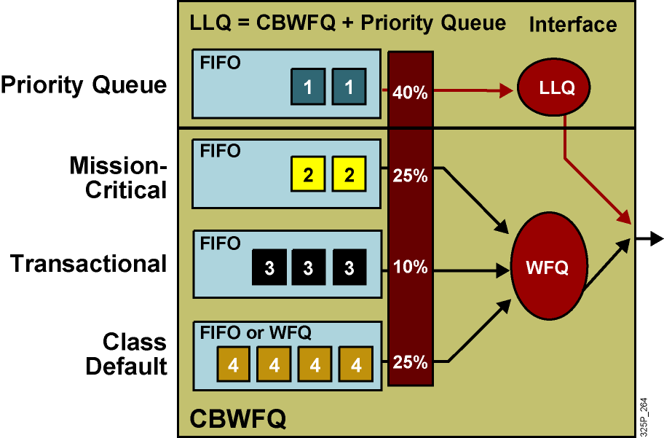
Kombinácia frontových mechanizmov
MQC dovoľuje kombinovať frontové režimy a vytvárať tak flexibilnejšie nástroje
Notes:
1
Neither the basic queuing methods nor the more advanced weighted fair queuing (WFQ) methods completely solve the quality of service (QoS) problems resulting from converged network traffic. The following problems remain:
If only a priority queue is used for a voice-enabled network, voice gets the needed priority. However, data traffic would suffer.
If only custom queuing (CQ) is used for a voice-enabled network, data traffic is assured of some bandwidth. However, voice traffic would suffer delays.
If WFQ is used, voice still experiences delay even when treated “fairly” by WFQ.
In PQ and CQ, all of the classification, marking, and queuing mechanisms are complicated to use and time-consuming when applied on an interface-by-interface basis.
Newer queuing mechanisms combine the best aspects of existing queuing methods. Low latency queuing (LLQ) is a combination of class-based weighted fair queuing (CBWFQ), which assigns weights according to bandwidth, and a priority system based on class that gives voice the priority it requires while ensuring that data is serviced efficiently. This solves the potential starvation problem of the priority queue by including a policing function based on the configured bandwidth of the priority system.

Slide 35
Class-Based Weighted Fair Queuing
CBWFQ je mechanizmus, ktorý má garantovať pásmo jednotlivým triedam
CBWFQ rozširuje štandardné WFQ o podporu používateľsky definovaných tried prevádzky
Triedy sú identifikované na základe class-map
Pre každú triedu je vyhradený jeden konverzačný front a doň je umiestňovaná prevádzka patriaca do danej triedy
Váha pre jednu triedu je vypočítaná ako podiel
InterfaceBandwidth/ClassBandwidth
Notes:
1
CBWFQ extends the standard WFQ functionality to provide support for user-defined traffic classes. With CBWFQ, the user defines the traffic classes based on match criteria, including protocols, ACLs, and input interfaces. Packets satisfying the match criteria for a class constitute the traffic for that class. A queue is reserved for each class, and traffic belonging to a class is directed to that class queue.
After a class has been defined and its match criteria have been formulated, you can assign characteristics to the class. To characterize a class, you assign a bandwidth and a maximum packet limit to it. The bandwidth assigned to a class is the minimum bandwidth delivered to the class during congestion.
To characterize a class, you also specify the queue limit for that class, which is the maximum number of packets allowed to accumulate in the class queue. The queuing guarantees the minimum bandwidth, but also gives a class unlimited access to more bandwidth if more is available. After a queue has reached its configured queue limit, enqueuing of additional packets to the class causes tail drop or random packet drop, depending on how the class policy is configured. You can configure up to 64 discrete classes in a service policy.

Slide 36
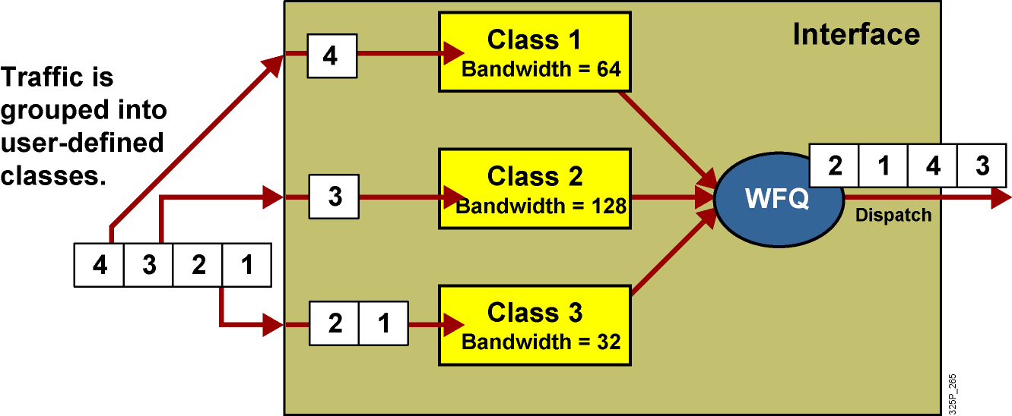
Architektúra CBWFQ
Notes:
1
CBWFQ supports multiple class maps to classify traffic into its corresponding FIFO queues.
CBWFQ classes use tail drop unless you explicitly configure a policy for a class to use weighted random early detection (WRED) to drop packets as a means of avoiding congestion. Note that if you use the WRED packet drop instead of tail drop for one or more classes in a policy map, you must ensure that WRED is not configured for the interface to which you attach that service policy.
Serial interfaces at E1 (2.048 Mbps) and below use WFQ by default—other interfaces use FIFO by default. Enabling CBWFQ on a physical interface overrides the default interface queuing method.
Be cautious when configuring CBWFQ on ATM interfaces. Enabling CBWFQ on an ATM permanent virtual circuit (PVC) does not override the default queuing method. Unspecified bit rate (UBR) connections do not support CBWFQ.

Slide 37
Plánovací mechanizmus v CBWFQ
CBWFQ garantuje prenosové pásmo jednotlivým triedam
Váhy jednotlivých tried sú interne vypočítané na základe pásma prideleného danej triede a celkového pásma na rozhraní
Pridelené pásmo môže byť dané pomocou:
Príkazu bandwidth (kbps), nemôže prekročiť hodnotu
InterfaceBandwidth * MaxReservedBandwidth
Percent pásma (bandwidth percent), nemôže prekročiť hodnotu
MaxReservedBandwidth
Percentami zostávajúceho pásma (bandwidth remaining percent), pričom zostávajúce pásmo je dané vzťahom
InterfaceBandwidth * MaxReservedBandwidth – Priority
V jednej policy-map nie je možné tieto spôsoby definovania pásma v príkaze bandwidth kombinovať
Notes:
1
The CBWFQ mechanism calculates weights based on the available bandwidth. These weights are then used by the CBWFQ scheduling mechanism to dispatch the packets. You can configure bandwidth guarantees by using one of the following commands:
The bandwidth command allocates a fixed amount of bandwidth by specifying the amount in kilobits per second. The reserved bandwidth is subtracted from the available bandwidth of the interface where the service policy is used. The allocated bandwidth must also be within the configured reservable limit (75 percent of interface bandwidth by default).
The bandwidth percent command can be used to allocate a percentage of the total available bandwidth of an interface. The total interface bandwidth is defined by using the bandwidth interface command. It is recommended that the bandwidth command reflect the real speed of the link. The allocated bandwidth is subtracted from the available bandwidth of the interface where the service policy is used.
The bandwidth remaining percent command is used to allocate the amount of guaranteed bandwidth based on a relative percentage of available bandwidth. When the bandwidth remaining percent command is configured, hard bandwidth guarantees may not be provided, and only relative per-class bandwidths are assured.
A single service policy cannot mix the bandwidth (fixed, in kilobits per second) and bandwidth percent commands (except with strict-priority queues).

Slide 38
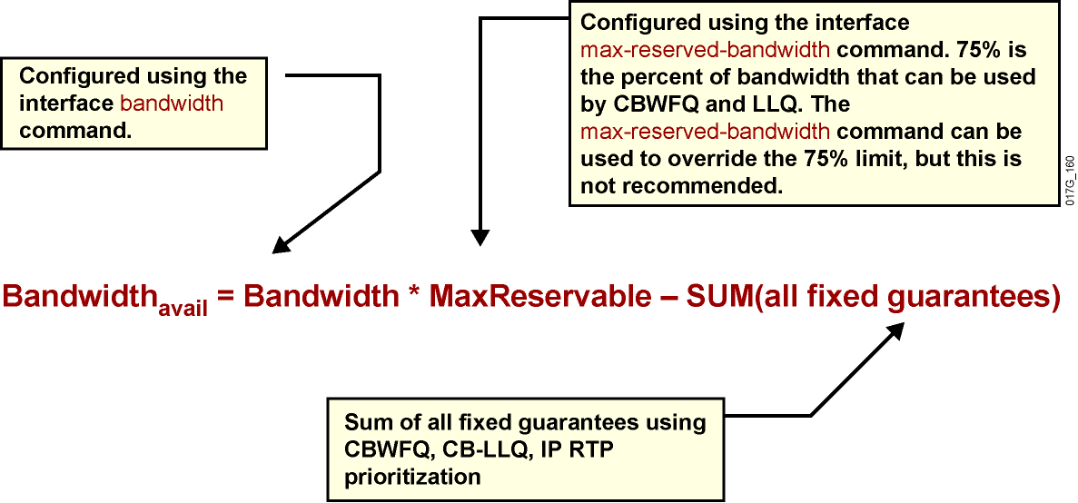
Rezervovateľné pásmo
Notes:
1
The available bandwidth displayed by the show interface command is calculated by subtracting all fixed bandwidth reservations from the default 75 percent of the configured bandwidth of an interface.
The available bandwidth is calculated with the following formula as shown.
You can calculate the required bandwidth by adding the bandwidth requirements for each major application (for example, voice, video, and data). The resulting sum represents the minimum bandwidth requirement for any given link, and it should not exceed 75 percent of the total available bandwidth for the link. The remaining 25 percent is used for other overhead.
You can override the 75 percent maximum sum allocated to all classes or flows using the max-reserved-bandwidth command. If you want to override the default 75 percent, exercise caution and ensure that you allow enough remaining bandwidth to support best-effort and control traffic and Layer 2 overhead such as Layer 2 keepalive messages, as well as the class default traffic.
If all of the bandwidth is not allocated, the remaining bandwidth is proportionately allocated among the classes based on the configured bandwidth of the classes.

Slide 39
Výhody a nevýhody CBWFQ
Výhody | Triedy definované podľa individuálnych potrieb Garancia minimálneho pásma Dobrá granularita a škálovateľnosť
Nevýhody | Hlasová prevádzka ešte vždy môže byť neprimerane zdržaná
Notes:
1
CBWFQ allows you to define traffic classes based on custom-defined match criteria such as ACLs, input interfaces, and protocol type.
The benefits and drawback of CBWFQ described as follows:
Classification: CBWFQ allows custom-defined classifications based on many parameters, such as ACLs, input interfaces, byte count, and so on.
Bandwidth allocation: CBWFQ allows you to specify the exact minimum bandwidth to be allocated for a specific class of traffic. Taking into account available bandwidth on the interface, you can configure up to 64 classes and control distribution among them, which is not the case with the flow-based WFQ. Flow-based WFQ applies weights to traffic to classify it into conversations and determines how much bandwidth each conversation is allowed, relative to other conversations. For flow-based WFQ, these weights, and traffic classification, are dependent on and limited to IP precedence levels.
Finer granularity and scalability: CBWFQ allows you to define what constitutes a class based on criteria that exceed the confines of flow. You do not need to maintain traffic classification on a per-flow basis. Moreover, you can configure up to 64 discrete classes in a service policy.
The drawback is that voice traffic can still suffer from unacceptable delays if you use CBWFQ as the only queuing mechanism.

Slide 40
Konfigurácia CBWFQ v policy-map
router(config-pmap-c)#
bandwidth bandwidth
Danej triede pridelí isté minimálne pásmo
Hodnota je v Kbps
router(config-pmap-c)#
bandwidth percent percent
Danej triede alokuje isté percento pásma rozhrania
Na výpočet sa berie celé prenosové pásmo rozhrania podľa príkazu bandwidth
router(config-pmap-c)#
bandwidth remaining percent percent
Danej triede alokuje isté percento zo zvyšného (neprideleného) pásma rozhrania (čo zostáva po nerezervovateľnom pásme a priorite)
Notes:
1
The bandwidth command within the policy-map class configuration command is used to specify or modify the bandwidth allocated for a class belonging to a policy map.
All classes belonging to one policy map should use the same type of bandwidth guarantee, in kilobits per second, percentage of interface bandwidth, or percentage of available bandwidth.
Configuring bandwidth in percentages is most useful when the underlying link bandwidth is unknown or the relative class bandwidth distributions are known.
These restrictions apply to the bandwidth command:
If the percent keyword is used, the sum of the class bandwidth percentages cannot exceed 100 percent.
The amount of bandwidth configured should be large enough to accommodate Layer 2 overhead.
A policy map can have all the class bandwidths specified in kilobits per second or in percentages but not a mix of both. However, the unit for the priority command in the priority class can be different from the bandwidth unit of the low-priority class.

Slide 41
Konfigurácia CBWFQ v policy-map
router(config-pmap-c)#
queue-limit queue-limit
Definuje maximálny počet paketov pre daný konverzačný front patriaci triede
router(config-pmap-c)#
fair-queue [number-of-dynamic-queues]
Trieda class-default a od verzie IOSu 15.x aj iné triedy môžu byť nastavené, aby vnútorne využívali klasický WFQ pre jemnejšiu obsluhu individuálnych tokov
Iné triedy než class-default však vyžadujú pre aktiváciu WFQ prítomnosť príkazu bandwidth
Počet dynamických frontov nie je nevyhnutný, povolené hodnoty sú v mocninách 2 od 16 po 4096
Notes:
1
The default queue limit of 64 packets can be changed using the queue-limit command. It is recommended that you not change the default value.
The default class can be selected by specifying the class-default name of the class. The default class supports two types of queuing: a FIFO queue (default) or a flow-based WFQ system. Both types can be combined with WRED. A FIFO queue can also get a minimum bandwidth guarantee.

Slide 42
Monitoring CBWFQ
Router#show policy-map interface
FastEthernet0/0
Service-policy output: policy1
Class-map: class1 (match-all)
0 packets, 0 bytes
5 minute offered rate 0 bps, drop rate 0 bps
Match: access-group 101
Queueing
Output Queue: Conversation 265
Bandwidth 3000 (kbps) Max Threshold 30 (packets)
(pkts matched/bytes matched) 0/0
(depth/total drops/no-buffer drops) 0/0/0
<...part of the output omitted...>
Class-map: class-default (match-any)
0 packets, 0 bytes
5 minute offered rate 0 bps, drop rate 0 bps
Match: any
Queueing
Flow Based Fair Queueing
<...rest of the output omitted...>
Notes:
1
the show policy-map interface command displays all service policies applied to the interface.
As an example, a policy including policing parameters, queuing mechanism, bandwidth and statistics is applied on the FastEthernet 0/0 interface. The class1 class map classifies any traffic matched by ACL 101 as CBWFQ. Also, bandwidth of 3000 kbps is displayed. Traffic not matching the configured classification (class1 and class2) will be placed in the class-default class map.

Slide 43
Low Latency Queuing (LLQ)
Za názvom LLQ sa skrýva kombinácia jedného prioritného frontu a ľubovoľného počtu ďalších frontov obsluhovaných CBWFQ mechanizmom
Prioritný front je obsluhovaný prednostne, kým sú v ňom pakety. Až keď je prázdny, plánovač začne obsluhovať CBWFQ fronty
Pre triedu s prioritným frontom je garantované
Odoslanie paketov s najmenšou možnou latenciou
Minimálne prenosové pásmo
Implicitný policing – obmedzenie celkovej využitej kapacity
Implicitný policing sa prejaví iba v prípade zahltenia rozhrania a aktivácie LLQ
V jednej policy-map však môže byť viacero tried konfigurovaných ako prioritné triedy
Ich pakety pôjdu do spoločného, jediného prioritného frontu, avšak každá trieda bude mať vlastný nezávislý policing
Notes:
1
Although WFQ provides a fair share of bandwidth to every flow and provides fair scheduling of its queues, it cannot provide guaranteed bandwidth and low delay to selected applications. For example, voice traffic may still compete with other aggressive flows in the WFQ queuing system because the WFQ system lacks priority scheduling for time-critical traffic classes.
For CBWFQ, the weight for a packet belonging to a specific class is derived from the bandwidth that you assigned to the class when you configured it. Therefore, the bandwidth assigned to the packets of a class determines the order in which packets are sent. All packets are serviced fairly based on this internal weight; no class of packets may be granted strict priority. This scheme poses problems for voice traffic, which is largely intolerant of delay, especially variation in delay. For voice traffic, variations in delay introduce irregularities of transmission heard as jitter in the conversation.
LLQ reduces the jitter in voice conversations. To enqueue real-time traffic to a strict-priority queue, you configure the priority command for the class after you specify the named class within a policy map. (Classes to which the priority command is applied are considered priority classes.) Within a policy map, you can give one or more classes priority status. When multiple classes within a single policy map are configured as priority classes, all traffic from these classes is enqueued to the same, single, strict priority queue.

Slide 44
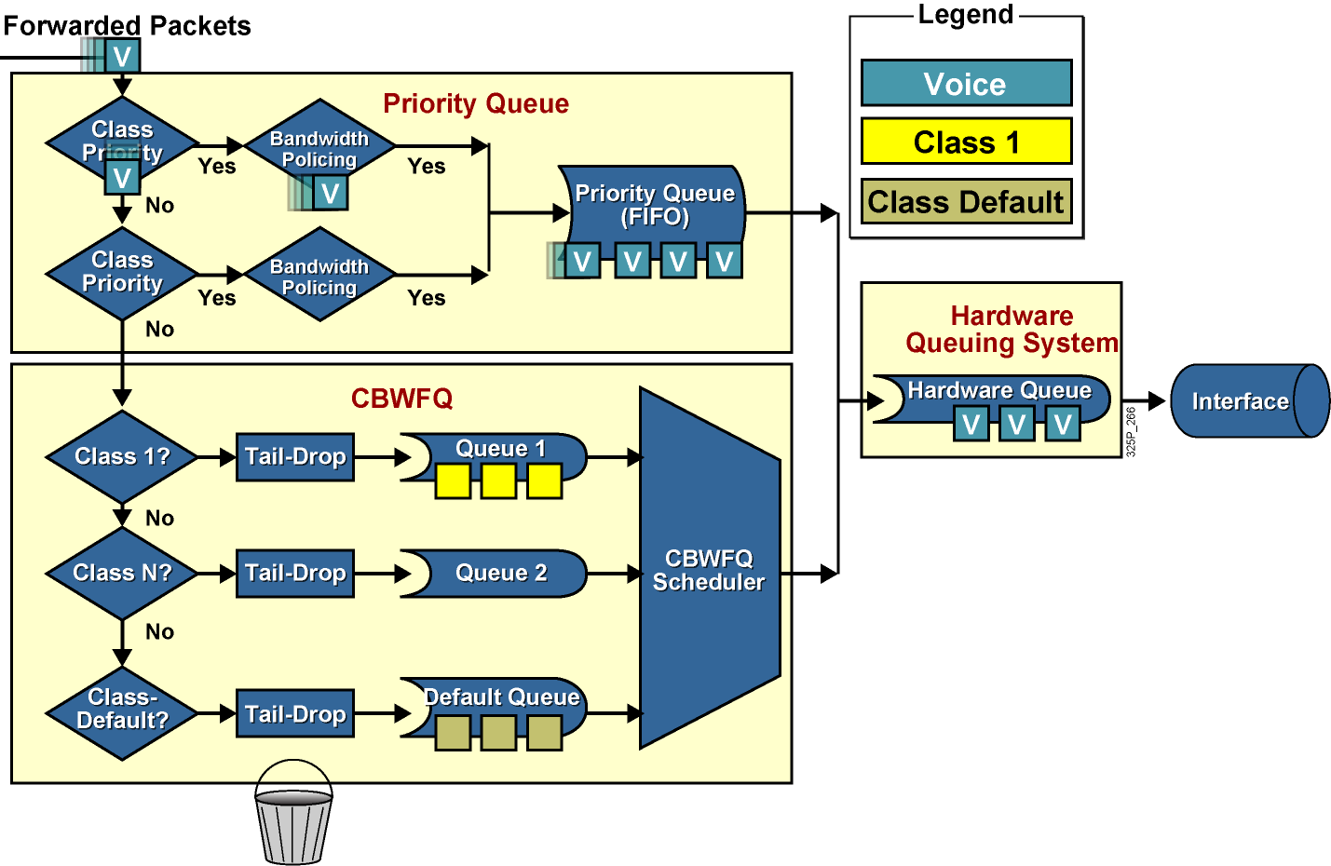
Architektúra LLQ
Notes:
1
LLQ extends CBWFQ by adding strict-priority queuing.
Strict-priority queuing allows delay-sensitive data such as voice to be dequeued and sent first. Voice packets that enter the LLQ system are sent to the priority queue part of the LLQ system, where they have a fixed bandwidth allocation and where they are served first. Data packets enter the CBWFQ system directly where CBWFQ assigned weights determine how they are treated.
Without LLQ, CBWFQ provides weighted queuing based on defined per-class bandwidth with no strict-priority queue available for real-time traffic. CBWFQ allows you to define traffic classes and then assign characteristics to that class. For example, you can designate the minimum bandwidth delivered to the class during congestion.

Slide 45
Konfigurácia LLQ
router(config-pmap-c)#
priority bandwidth [burst]
Danej triede alokuje garanciu minimálneho pásma v Kbps a zaistí najskoršiu možnú obsluhu
V prípade zahltenia rozhrania bude aktivovaný aj implicitný policing
Parameter burst stanovuje objem dát, ktoré je možné odoslať naraz ako zhluk – vstupuje do parametrov výpočtu činnosti policingu
router(config-pmap-c)#
priority percent percentage [burst]
Danej triede alokuje stanovenú percentáž pásma rozhrania a zaistí najskoršiu možnú obsluhu
Ostatné vlastnosti platia, ako sú uvedené vyššie
Notes:
1
When you specify the priority command for a class, you can use the bandwidth argument to specify the maximum bandwidth in kilobits per second.
You use this parameter to specify the maximum amount of bandwidth allocated for packets belonging to the class configured with the priority command. The bandwidth parameter both guarantees bandwidth to the priority class and restrains the flow of packets from the priority class.
Keep the following guidelines in mind when using the priority command:
Layer 2 encapsulations are accounted for in the amount of bandwidth specified with the priority command. Therefore, ensure that a bandwidth allocation is configured with room for the Layer 2 overhead.
Use the priority command for VoIP on serial links and ATM PVCs.

Slide 46
Kombinovanie typov tried v policy-map
Jedna policy-map môže obsahovať triedy rôznych typov
Triedy typu priority a priority percent v ľubovoľnej kombinácii
Triedy typu bandwidth, avšak ich štýl musí byť spoločný
Buď všetky štýlu bandwidth
Alebo všetky štýlu bandwidth percent
Alebo všetky štýlu bandwidth remaining percent
Každé sieťové rozhranie má parametre bandwidth a max-reserved-bandwidth
V starších IOSoch je implicitne dovolené rezervovať 75%, v novších 100% deklarovaného pásma a príkaz max-... je skrytý
Suma celkového pásma rezervovaného jednotlivým triedam nemôže prekročiť hodnotu bandwidth * max-reserved-bandwidth

Slide 47
Ukážka konfigurácie LLQ
class-map voip
match ip precedence 5
!
class-map mission-critical
match ip precedence 3 4
!
class-map transactional
match ip precedence 1 2
!
policy-map Policy1
class voip
priority percent 10
class mission-critical
bandwidth percent 30
class transactional
bandwidth percent 20
class class-default
fair-queue
Notes:
1
This is a configuration example where the VoIP traffic class, classified based on the IP precedence of 5, is queued in the LLQ priority queue. The priority class is guaranteed but is also limited to 10 percent of interface bandwidth.

Slide 48
Monitoring LLQ
router>
show policy-map interface interface
router> show policy-map interface fastethernet 0/0
FastEthernet0/0
Service-policy output: LLQ
Class-map: LLQ (match-any)
0 packets, 0 bytes
5 minute offered rate 0 bps, drop rate 0 bps
Match: any
Weighted Fair Queueing
Strict Priority
Output Queue: Conversation 264
Bandwidth 1000 (kbps) Burst 25000 (Bytes)
(pkts matched/bytes matched) 0/0
(total drops/bytes drops) 0/0
Class-map: class-default (match-any)
0 packets, 0 bytes
5 minute offered rate 0 bps, drop rate 0 bps
Match: any
Notes:
1
The show policy-map interface command displays the packet statistics of all classes that you configured for all service policies on the specified interface.
Class-map: Class of traffic being displayed. Output is displayed for each configured class in the policy.
offered rate: Rate, in kilobits per second, of packets entering the class.
drop rate: Rate, in kilobits per second, at which packets are dropped from the class. The drop rate is calculated by subtracting the number of successfully transmitted packets from the offered rate.
Match: Match criteria specified for the class of traffic.
pkts matched/bytes matched: Number of packets (shown in bytes) matching this class that were placed in the queue.
depth/total drops/no-buffer drops: Number of packets, in bytes, discarded for this class. “No-buffer” indicates that no memory buffer exists to service the packet.

Slide 49

Predchádzanie zahlteniu
Notes:
1

Slide 50
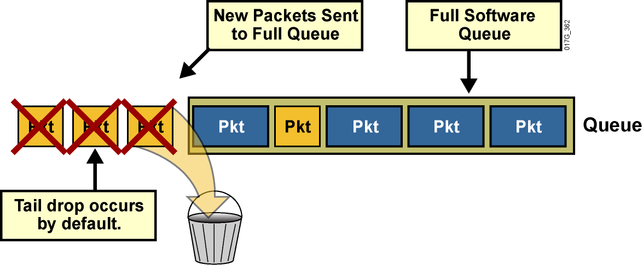
Tail Drop – riešenie preplnenia frontov
Aj TxQ rozhrania, aj softvérové fronty majú svoju konečnú dĺžku
Ak je front preplnený, prirodzené správanie sa je, že ďalšie prichádzajúce pakety niet kam umiestniť, takže sa zahodia
Táto situácia sa nazýva Tail Drop a má nevýhody
Notes:
1
When an interface on a router cannot transmit a packet immediately, the packet is queued, either in an interface transmit (Tx) ring or the interface output hold queue, depending on the switching path that is used. Packets are then taken out of the queue and eventually transmitted on the interface.
If the arrival rate of packets to the output interface exceeds the ability of the router to buffer and forward traffic, the queues increase to their maximum length and the interface becomes congested. Tail drop is the default queuing response to congestion. Tail drop treats all traffic equally and does not differentiate among classes of service.
This graphic shows tail drop occurring by default. Applications may suffer performance degradation stemming from packet loss caused by tail drop. When the output queue is full and tail drop is in effect, all packets trying to enter (at the tail of) the queue are dropped until the queue is no longer full.
Weighted fair queuing (WFQ), if configured on an interface, provides a more sophisticated scheme for dropping traffic. WFQ punishes the most aggressive flows using a congestive discard threshold (CDT)-based dropping algorithm.

Slide 51
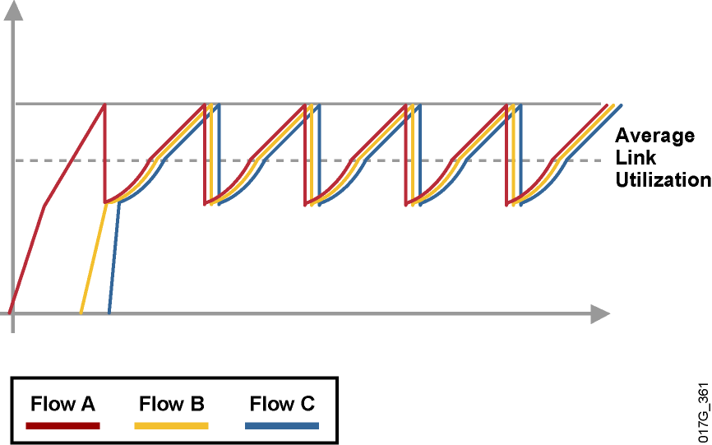
Jav TCP synchronizácie
Predpokladajme, že cez rozhranie prechádza veľa TCP tokov, ktorých objem rastie
Ak dôjde k Tail Drop-u, je pravdepodobné, že sa stratia segmenty mnohých alebo všetkých tokov
Všetky toky spoločne spomalia a potom začnú spoločne zrýchľovať, čím sa situácia začne opakovať
Notes:
1
Global synchronization is a TCP-related phenomenon that reduces optimal throughput of network applications. Tail drop contributes to this phenomenon.
A router can handle multiple concurrent TCP sessions. However, bursty network traffic could cause a router to fail if the traffic exceeds the queue limit.
This graphic illustrates the issue of TCP synchronization. If the receiving router drops all traffic that exceeds the queue limit (the default tail drop action), many TCP sessions then simultaneously go into slow start. Traffic temporarily slows down to the extreme, and then all flows go into slow start again. This activity creates a condition called global synchronization.
Global synchronization occurs as waves of congestion crest, only to be followed by troughs during which the transmission link is not fully used. Global synchronization of TCP hosts can occur because packets are dropped all at once. Global synchronization occurs when multiple TCP hosts reduce their transmission rates in response to packet dropping. When congestion is reduced, their transmission rates are increased.
The waves of transmission known as global synchronization result in significant link underutilization.

Slide 52
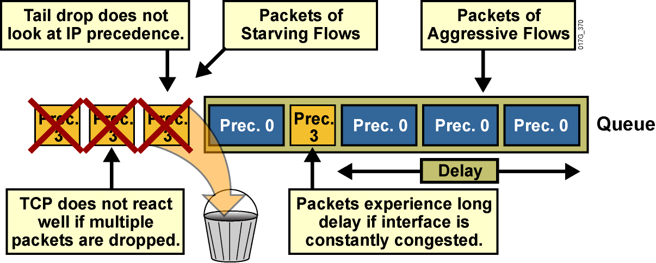
Ďalšie nevýhody Tail Drop
Trvalé vysoké zaplnenie frontu vnáša dodatočné oneskorenie
Premenlivé zaplnenie frontu vnáša jitter
Agresívne toky s veľkými paketmi zaplnia front rýchlo a nepustia k slovu toky s menšími paketmi, ktoré sú menej agresívne
Tail Drop nezohľadňuje, že nezmestivší sa paket je možno dôležitejší ako všetky, čo už vo fronte stoja
Notes:
<number>
Another TCP-related phenomenon that reduces optimal throughput of network applications is TCP starvation.
When multiple flows are being transmitted through a router, some of these flows may be much more aggressive than other flows. For instance, when the TCP transmit window increases for file-transfer applications, the TCP session can send a number of large packets to its destination. These packets immediately fill the queue on the router, and other, less aggressive flows can be starved because there is no differentiated treatment indicating which packets should be dropped. As a result, less aggressive flows are dropped at the output interface.
Again, tail drop does not address this issue.

Slide 53
Random Early Detection (RED)
Ak by bolo možné predísť preplneniu frontu, bolo by možné predísť aj Tail Drop-u
Základnou ideou predchádzania je zahadzovať pakety náhodne a v predstihu
Náhodné zahadzovanie postihne len časť tokov, nie všetky, a nebude mať povahu iba „skôr aktivovaného Tail Drop-u“
Pravdepodobnosť zahodenia bude tým vyššia, čím vyššie bude priemerné obsadenie frontu
Dôsledky:
TCP relácie sa postupne prispôsobia kapacite rozhrania
Priemerná dĺžka frontu bude menšia
Predíde sa globálnej synchronizácii TCP tokov
Notes:
<number>
Random early detection (RED) is a dropping mechanism that randomly drops packets before a queue is full, thus helping to avoid tail drop.
The basis of the dropping strategy is the average queue length—that is, when the average size of the queue increases, RED is more likely to drop an incoming packet than when the average queue length is shorter.
Because RED drops packets randomly, it has no per-flow intelligence. The rationale is that an aggressive flow will represent most of the arriving traffic, and it is likely that RED will drop a packet of an aggressive session. RED therefore punishes more aggressive sessions with a higher statistical probability and is able to somewhat selectively slow the most significant cause of congestion. Directing one TCP session at a time to slow down allows for full utilization of the bandwidth rather than utilization that manifests itself as crests and troughs of traffic.
As a result of implementing RED, TCP global synchronization is much less likely to occur, and TCP can use link bandwidth more efficiently.
In RED implementations, the average queue size also decreases significantly because the possibility of the queue filling up is reduced. This is because RED is very aggressive in tail dropping when traffic bursts occur and the queue is already quite full.
RED distributes losses over time and normally maintains a low queue depth while absorbing traffic spikes. RED can also utilize IP precedence or differentiated services code point (DSCP) bits in packets to establish different drop profiles for different classes of traffic.
RED is useful only when the bulk of the traffic is TCP traffic. With TCP, dropped packets indicate congestion, so the packet source reduces its transmission rate. With other protocols, packet sources might not respond or might re-send dropped packets at the same rate, and so dropping packets might not decrease congestion.

Slide 54
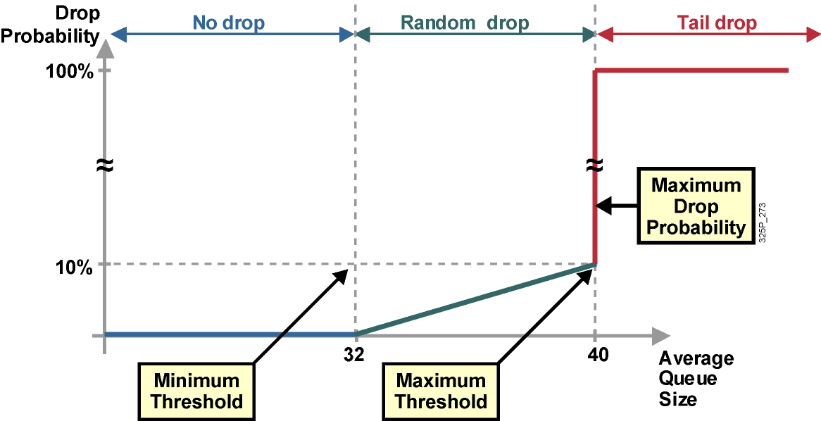
Profil RED
Notes:
<number>
RED uses a traffic profile to determine the packet-dropping strategy based on the average queue length. The packet drop probability is based on the minimum threshold, maximum threshold, and mark probability denominator. When the average queue depth is above the minimum threshold, RED starts dropping packets. The rate of packet drop increases linearly as the average queue size increases until the average queue size reaches the maximum threshold.
The figure shows that depending on queue length, the profile assigns a no drop, a random drop or full drop probability.
The probability of a packet being dropped is based on three configurable parameters contained within the RED profile:
Minimum threshold: When the average queue length is above the minimum threshold, RED starts dropping packets. The rate of packet drop increases linearly as the average queue size increases, until the average queue size reaches the maximum threshold.
Maximum threshold: When the average queue size is above the maximum threshold, all packets are dropped.
Mark probability denominator: This number is the fraction of packets that are dropped when the average queue depth is at the maximum threshold. For example, if the denominator is 512, one out of every 512 packets is dropped when the average queue is at the maximum threshold. The linear increase of packet drops from the minimum threshold (0 drops) to the maximum threshold is based on this parameter and the queue size between the minimum and maximum thresholds.
The minimum threshold value should be set high enough to maximize link utilization. If the minimum threshold is too low, packets may be dropped unnecessarily, and the transmission link will not be fully used.
The difference between the maximum threshold and the minimum threshold should be large enough to avoid global synchronization. If the difference is too small, many packets may be dropped at once, resulting in global synchronization.

Slide 55
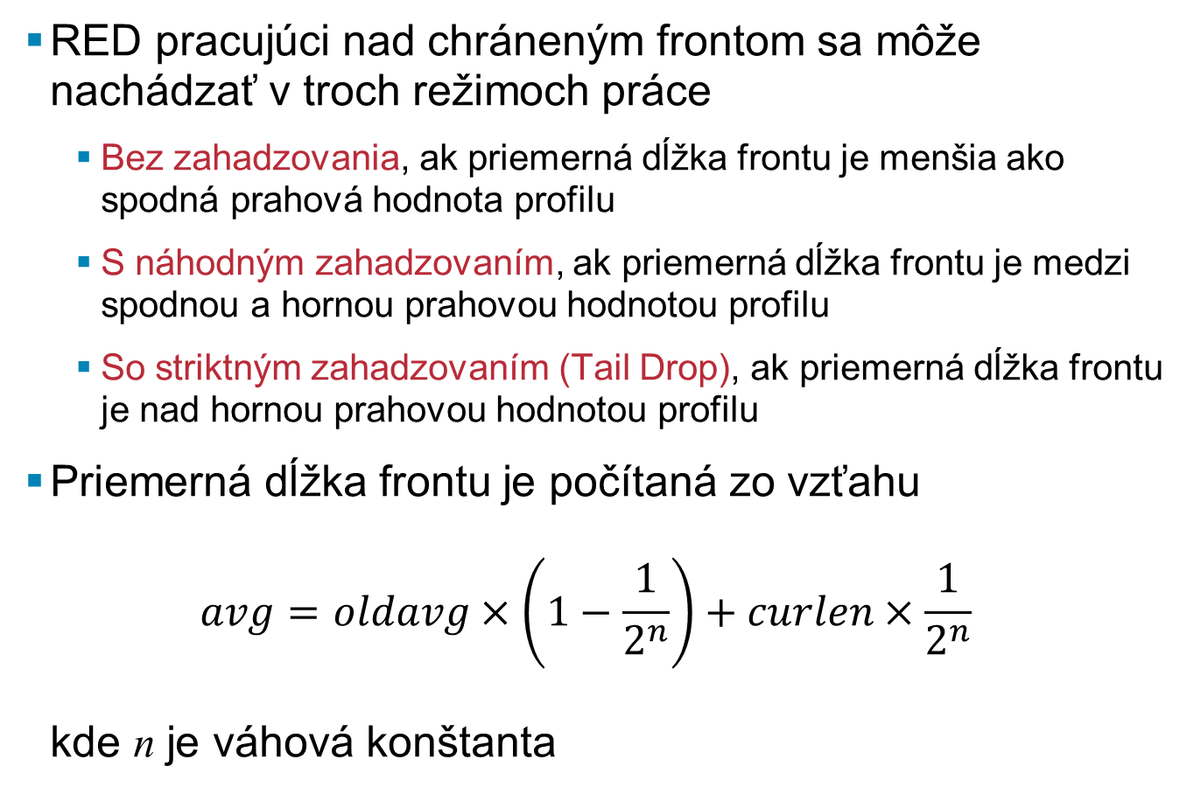
Režimy práce RED
RED pracujúci nad chráneným frontom sa môže nachádzať v troch režimoch práce
Bez zahadzovania, ak priemerná dĺžka frontu je menšia ako spodná prahová hodnota profilu
S náhodným zahadzovaním, ak priemerná dĺžka frontu je medzi spodnou a hornou prahovou hodnotou profilu
So striktným zahadzovaním (Tail Drop), ak priemerná dĺžka frontu je nad hornou prahovou hodnotou profilu
Priemerná dĺžka frontu je počítaná zo vzťahu kde n je váhová konštanta
Notes:
<number>
Three RED dropping modes can be used in TCP that are based on the average queue size:
When the average queue size is between 0 and the configured minimum threshold, no drops occur and all packets are queued.
When the average queue size is between the configured minimum threshold and the configured maximum threshold, random drops occur, which is linearly proportional to the mark probability denominator and the average queue length.
When the average queue size is at or higher than the maximum threshold, RED performs full (tail) drop in the queue. This situation is unlikely, because RED should slow down TCP traffic ahead of congestion. If a lot of non-TCP traffic is present, RED cannot effectively drop traffic to reduce congestion, and tail drops are likely to occur.

Slide 56
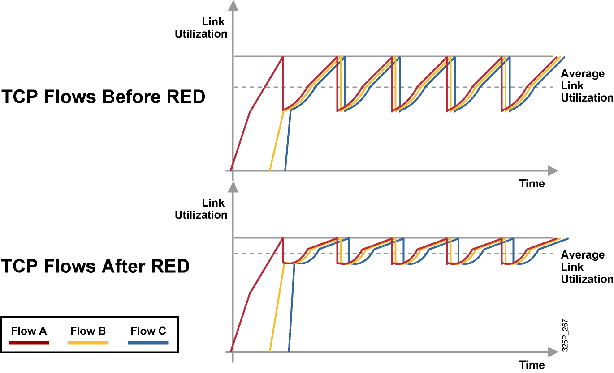
Vplyv RED na TCP toky
Notes:
<number>
These graphics show TCP throughput behavior compared to link bandwidth in a congested network scenario where the tail-drop and RED mechanisms are in use on the link.
Before RED, when all sessions slow down, congestion on the router interface is removed and all TCP sessions restart their transmission at about the same time. Again, the router interface quickly becomes congested, causing tail drop. As a result, all TCP sessions back off again. This behavior cycles constantly, resulting in a link that is generally underutilized.
After RED is applied, RED randomly drops packets, influencing a small number of sessions at a time, before the interface reaches congestion. Overall throughput of sessions is increased, as is average link utilization. Global synchronization is very unlikely to occur because of selective, but random, dropping of adaptive traffic.

Slide 57
Weighted Random Early Detection (WRED)
WRED je implementácia individuálneho RED profilu pre jednotlivé triedy prevádzky
Každý profil je úplne definovaný
Spodnou prahovou hodnotou
Hornou prahovou hodnotou
Hodnotou menovateľa maximálnej pravdepodobnosti zahodenia
Výber konkrétneho WRED profilu sa môže udiať podľa
IP precedencie (8 profilov)
DSCP (64 profilov)
WRED je možné aplikovať v policy-map v jednotlivých triedach
Staršie IOSy umožňovali WRED aktivovať aj priamo na rozhraní
Notes:
<number>
Cisco does not support RED. Instead, Cisco supports weighted random early detection (WRED) which combines RED with IP precedence or DSCP and performs packet dropping based on IP precedence or DSCP markings.
For example, a packet with an IP precedence value of 0 might have a minimum threshold of 20 packets, whereas a packet with an IP precedence of 1 might have a minimum threshold of 25 packets. In this example, packets with an IP precedence of 0 would start to be discarded before packets with an IP precedence of 1.
As with RED, WRED monitors the average queue length in the router and determines when to begin discarding packets based on the length of the interface queue. When the average queue length exceeds the user-specified minimum threshold, WRED begins to randomly drop packets with a certain probability. If the average length of the queue continues to increase so that it becomes larger than the user-specified maximum threshold, WRED reverts to a tail-drop packet-discard strategy, in which all incoming packets are dropped.
The idea behind using WRED is to maintain the queue length at a level somewhere below the maximum threshold and to implement different drop policies for different classes of traffic. WRED can selectively discard lower-priority traffic when the interface becomes congested and can provide differentiated performance characteristics for different classes of service. WRED can also be configured to produce nonweighted RED behavior.
For interfaces configured to use Resource Reservation Protocol (RSVP), WRED chooses packets from other flows to drop rather than the RSVP flows. Also, IP precedence or DSCP helps determine which packets are dropped, because traffic at a lower priority has a higher drop rate than traffic at a higher priority (and, therefore, lower-priority traffic is more likely to be throttled back). In addition, WRED statistically drops more packets from large users than from small users. The traffic sources that generate the most traffic are more likely to be slowed than traffic sources that generate little traffic.
WRED reduces the chances of tail drop by selectively dropping packets when the output interface begins to show signs of congestion. By dropping some packets early rather than waiting until the queue is full, WRED avoids dropping large numbers of packets at once and minimizes the chances of global synchronization. As a result, WRED helps maximize the utilization of transmission lines.
WRED treats non-IP traffic as precedence 0, the lowest precedence. Therefore, non-IP traffic, in general, is more likely to be dropped than IP traffic.
WRED should be used wherever there is a potential congested link (bottleneck), which could very well be an access or edge link; however, WRED is normally used in the core routers of a network rather than at the network edge. Edge routers assign IP precedence or DSCP to packets as they enter the network. WRED uses these assigned values to determine how to treat different types of traffic.
Note that Cisco does not recommend WRED for any voice queue, although you may enable WRED on an interface carrying voice traffic. WRED will not throttle back voice traffic because voice traffic is User Datagram Protocol (UDP)-based.

Slide 58
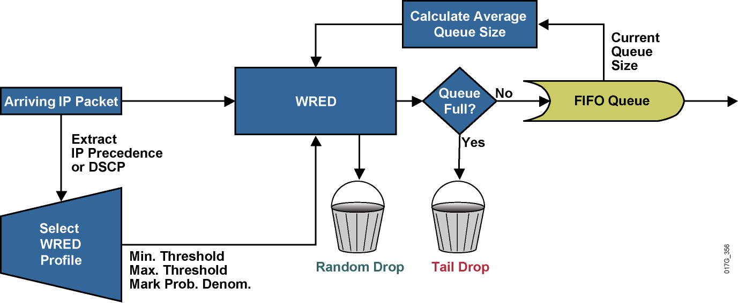
Stavebné bloky WRED
Notes:
<number>
There are several parameters used by WRED to influence packet-drop decisions.
The router constantly updates the WRED algorithm with the calculated average queue length, which is based on the recent history of queue lengths.
Configured in the traffic profile are the parameters that define the drop characteristics used by WRED (minimum threshold, maximum threshold, and mark probability denominator). These parameters define the WRED probability slopes.
When a packet arrives at the output queue, the IP precedence or DSCP value is used to select the correct WRED profile for the packet. The packet is then passed to WRED for processing. Based on the selected traffic profile and the average queue length, WRED calculates the probability for dropping the current packet and either drops the packet or passes it to the output queue.
If the queue is already full, the packet is dropped. Otherwise, the packet is eventually transmitted out to the interface. If the average queue length is greater than the minimum threshold but less than the maximum threshold, based on the drop probability, WRED either queues the packet or performs a random drop.

Slide 59
Class-Based WRED (CBWRED)
Class-based WRED je použitie Weighted RED v obsluhe jednotlivých tried prevádzky v policy-map
Kombinácia CBWFQ a CBWRED je nástroj pre implementáciu správnej obsluhy DSCP tried AFxy
Pre jednotlivé DSCP triedy a IP precedencie má Cisco východzie prednastavené hodnoty jednotlivých WRED profilov a váhových konštánt
Tieto nastavenia sa neodporúča meniť, pokým nie sú nové hodnoty podložené meraním a overením
Notes:
<number>
Traditionally, Cisco IOS software used stand-alone RED and WRED mechanisms to avoid congestion on an interface. Those mechanisms can perform a differentiated drop based on the IP precedence or DSCP value.
The class-based weighted fair queuing (CBWFQ) system supports the use of WRED inside the queuing system, thereby implementing class-based WRED (CBWRED).
Each class is queued in its separate queue and has a queue limit, performing tail drop by default. WRED can be configured as the preferred dropping method in a queue, implementing a differentiated drop based on traffic class or on the IP precedence or DSCP value.

Slide 60
Konfigurácia CBWRED podľa IP precedencie
router(config-pmap-c)#
random-detect
Tento príkaz aktivuje CBWRED, rozlišujúc jednotlivé profily pre riadenú prevádzku podľa staršieho systému IP precedencie
Non-IP prevádzka bude považovaná za prevádzku s precedenciou 0
policy-map Policy1
class mission-critical
bandwidth percent 30
random-detect
class transactional
bandwidth percent 20
random-detect
class class-default
fair-queue
random-detect
Notes:
<number>
The random-detect command is used to enable WRED on an interface. By default, WRED is IP precedence-based and uses eight default WRED profiles, one for each value of IP precedence.
Within the CBWFQ system, WRED is used to perform per-queue dropping within the class queues. Therefore, each class queue has its own WRED method, which can be further weighed based on the IP precedence or DSCP value. Each queue can therefore be configured with a separate drop policy to implement different drop policies for every class of traffic.
WRED treats all non-IP traffic as precedence 0. As a result, non-IP traffic is more likely to be dropped than IP traffic.
WRED cannot be configured on the same interface as custom queuing (CQ), priority queuing (PQ), or WFQ. However, CBWRED can be configured in conjunction with CBWFQ. Restricting nondistributed, non-class-based WRED to only FIFO queuing on an interface is typically not a major issue because WRED is usually applied in the network core, where advanced queuing mechanisms are not typically used. WRED is suited for the network core because WRED has a relatively low performance impact on routers.

Slide 61
Úprava CBWRED profilu pre IP precedenciu
router(config-pmap-c)#
random-detect precedence precedence min-threshold max-threshold mark-prob-denominator
Tento príkaz zadaný v policy-map a konkrétnej triede umožňuje predefinovať WRED profil pre danú triedu IP precedencie
Maximálna pravdepodobnosť náhodného zahadzovania pred aktiváciou striktného zahadzovania bude
1 / mark-prob-denominator
Obyčajný RED bez váh je možné získať nastavením profilov WRED pre všetky možné precedencie na tie isté parametre
Notes:
<number>
When WRED is enabled, default values are selected for each traffic profile based on the weight used (IP precedence or DSCP). Network administrators can then modify these default values to match their specific administrative quality of service (QoS) policy goals. This figure shows the command syntax for changing WRED traffic profiles.
When you are modifying the default WRED profile for IP precedence, the following values are configurable:
Minimum threshold: When the average queue depth is above the minimum threshold, WRED starts dropping packets. The rate of packet drop increases linearly as the average queue size increases, until the average queue size reaches the maximum threshold. The size of the hold queue is equivalent to the number of packets that can be held within a queue. The hold-queue length ranges from 0 to 4096, and, therefore, the minimum/maximum threshold range is 1 to 4096.
Maximum threshold: When the average queue size is above the maximum threshold, all packets are dropped. If the difference between the maximum threshold and the minimum threshold is too small, many packets might be dropped at once, resulting in global synchronization. The default maximum threshold will reflect the defined hold-queue size. Thus, if the hold queue is changed, the maximum threshold will change.
Mark probability denominator: This is the fraction of packets dropped when the average queue depth is at the maximum threshold. For example, if the denominator is 10, one out of every 10 packets is dropped when the average queue is at the maximum threshold. The maximum probability of drop at the maximum threshold can be expressed as 1 / mark-prob-denominator. The maximum drop probability is 10 percent if default settings are used that have a mark probability denominator value of 10. The value of the mark probability can range from 1 to 65,536.
If required, RED can be configured as a special case of WRED, by assigning the same profile to all eight IP precedence values. The default WRED parameter parameters are based on the best available data. It is recommended that these parameters not be changed from their default values unless you have determined that your applications will benefit from the changed values.

Slide 62
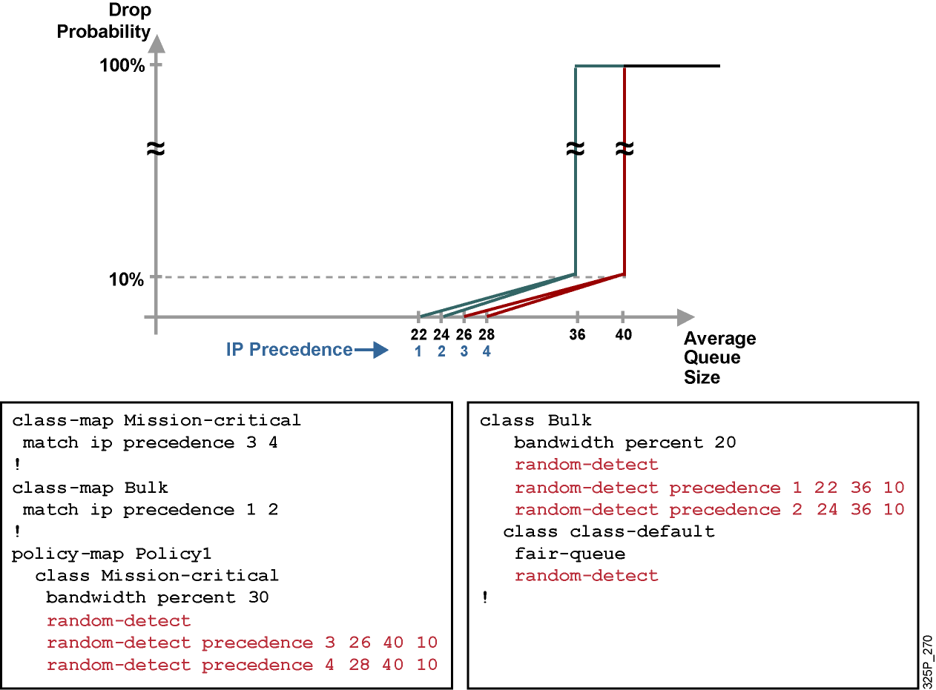
Príklad na použitie CBWRED
Notes:
<number>
This graphic shows the WRED traffic profile representing the QoS policy and the configuration that is used to implement the example service policy. The traffic is classified based on the IP precedence bits, and all noncontract traffic is classified into the default class:
The mission-critical class is guaranteed at least 30 percent of bandwidth with a custom WRED profile that establishes a low-drop and a high-drop PHB.
The bulk class is guaranteed at least 20 percent of bandwidth, is configured with somewhat lower WRED drop thresholds, and is therefore more likely to be dropped than the mission-critical class if interface congestion occurs.
All other traffic is part of the default class and is fair-queued with default WRED parameters.

Slide 63
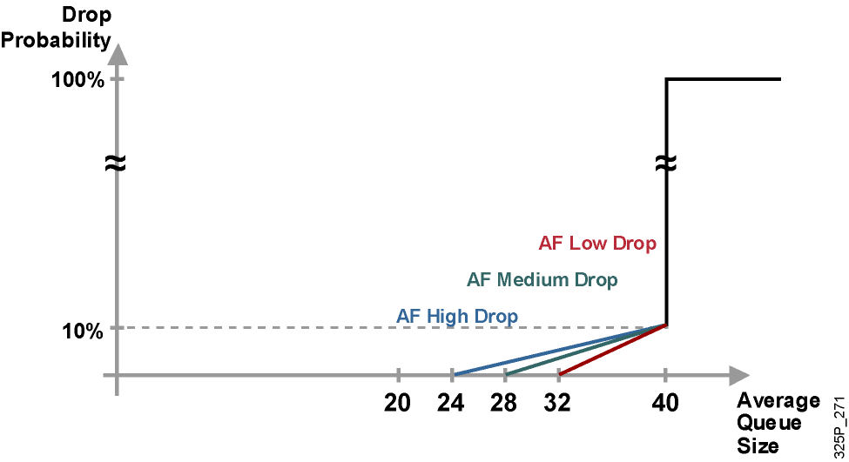
CBWRED pre triedy typu DSCP AF
Notes:
<number>
In DSCP, the following parameters identify Assured Forwarding (AF) PHB based on:
Guarantees a certain amount of bandwidth to an AF class.
Allows access to extra bandwidth, if available.
Packets requiring AF PHB should be marked with DSCP value aaadd0, where aaa is the number of the class and dd is the drop probability, or drop preference, of the traffic class.
There are four defined AF classes. Each class should be treated independently and have bandwidth allocated that is based on the QoS policy.
For the AF DiffServ traffic class, WRED configures itself by default for three different profiles, depending on the drop preference DSCP marking bits. Therefore, AF traffic should be classified into the three possible classes, such as AF high drop, AF medium drop, and AF low drop. These three classes are based on the sensitivity to packet drops of the application or applications represented by the class. This would mean that the mission-critical class would have an AF low drop, an AF medium drop, and an AF high drop.

Slide 64
Konfigurácia CBWRED podľa DSCP
router(config-pmap-c)#
random-detect dscp-based
V policy-map a konkrétnej triede aktivuje CBWRED s výberom profilu podľa DSCP
router(config-pmap-c)#
random-detect dscp dscpvalue min-threshold max-threshold mark-prob-denominator
Príkaz umožňuje predefinovať WRED profil pre zadanú hodnotu DSCP
Notes:
<number>
The random-detect dscp-based command is used to enable DSCP-based WRED on an interface. Changing WRED weighting to values based on DSCP increases the number of WRED traffic profiles to 64 (as compared to 8 profiles for precedence-based WRED). This graphic shows the command syntax.
You can configure WRED as part of the policy for a standard class or the default class. The WRED random-detect command and the WFQ queue-limit command are mutually exclusive for class policy. If you configure WRED, its packet-drop capability is used to manage the queue when packets exceeding the configured maximum count are enqueued. If you configure the WFQ queue-limit command for class policy, tail drop is used.
WRED cannot be configured on the same interface as custom queuing (CQ), priority queuing (PQ), or weighted fair queuing (WFQ). However, CB-WRED can be configured in conjunction with CBWFQ. Restricting nondistributed, non-class-based WRED only to FIFO queuing on an interface is not a major issue because WRED is usually applied in the network core, where advanced queuing mechanisms are not typically deployed. WRED is suited for the network core because it has a relatively low performance impact on routers.

Slide 65
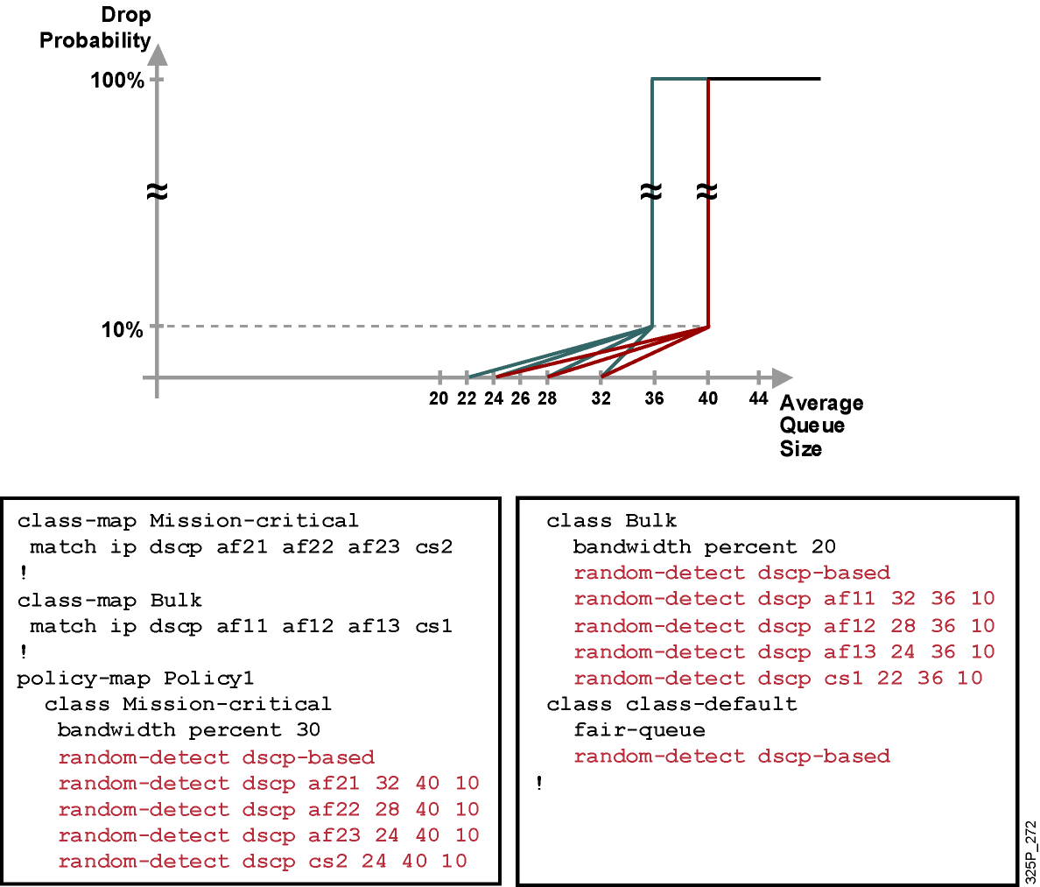
Príklad použitia CBWRED podľa DSCP
Notes:
<number>
To enforce this service policy, a router uses CBWFQ to perform bandwidth sharing and uses WRED within service classes to perform differentiated drop. This example shows sample drop profile graphs and outputs.
The configuration example shows how traffic classification is performed using DSCP-based classes, representing the mission-critical class as the AF1 class, and the bulk class as the AF2 class. WRED DSCP-based parameters are set reflecting the class-dependent drop strategy:
The mission-critical class is guaranteed at least 30 percent of bandwidth, with a custom WRED profile that establishes three different drop probabilities for AF class 2. The minimum threshold for DSCP AF21 packets is 32. The minimum threshold for DSCP AF22 packets is 28. The minimum threshold for DSCP AF23 and CS2 packets is 24. The maximum threshold for all Mission-critical traffic is 40 - the default maximum threshold is equal to the default hold queue size (40) on an interface. The (default) mark probability is 10 for the Mission-critical traffic (one out of every 10 packets is dropped when the average queue depth is at the maximum threshold – the average queue size changes with time as a function of the previously calculated average queue size and the current queue size).
The bulk class is guaranteed at least 20 percent of bandwidth, is configured with three different drop probabilities for AF class 1, and has a somewhat lower WRED maximum threshold. As a result, bulk-class traffic is more likely to be dropped than the mission-critical class if interface congestion occurs. The minimum threshold for DSCP AF11 packets is 32. The minimum threshold for DSCP AF12 packets is 28. The minimum threshold for DSCP AF13 packets is 24. The minimum threshold for DSCP CS1 packets is 24. The maximum threshold for all Mission-critical traffic is 36. The (default) mark probability is 10 for the Bulk traffic.
All other traffic is part of the default class and is fair-queued, with default WRED parameters.

Slide 66
Notes:
<number>

